Slide 1
ecology
Science 10
Notes:
This template can be used as a starter file for a photo album.

Slide 2
Topics
Population
Carrying Capacity
Productivity
Feeding People

Slide 3
Students are expected to:
Describe and apply classification systems and nomenclature with respect to trophic levels in ecosystems;
Describe the mechanisms of bioaccumulation, and explain its potential impact on the viability and diversity of consumers at all trophic levels; and
Explain how biodiversity of an ecosystem contributes to its sustainability.
Explain why the ecosystem may respond differently to short-term stress and long-term change.

Slide 4
Vocabulary
explosion
exceeds
limit
species
suitable

Slide 5
Populations

Slide 6
populations
group of organisms of the same species that exists in the same place at the same time

Slide 7
Populations Growth
Three factors can affect population size:
number of births
the number of deaths
the number of individuals that enter or leave the population.
* Simply put, a population will increase or decrease in size depending on how many individuals are added to it or removed from it.

Slide 8
Immigration & Emigration
Immigration
the movement of individuals into an area, is another factor that can cause a population to grow.
Emigration
the movement of individuals out of an area, can cause a population to decrease in size.

Slide 9
Word Origin
Immigration is formed from the Latin prefix in-, meaning “in,” and migrare, meaning “to move from one place to another.
If the Latin prefix e- means “out,” then which of the following means “migration out”?
A.) emigration
B.) migration
C.) immigration

Slide 10
Exponential Growth
Exponential Growth
If a population has abundant space and food, and is protected from predators and disease, then organisms in that population will multiply and the population size will increase.

Slide 11
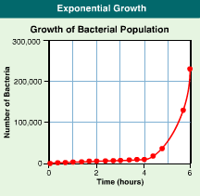

Slide 12
Exponential Growth
Exponential growth occurs when the individuals in a population reproduce at a constant rate.
Under ideal conditions with unlimited resources, a population will grow exponentially.

Slide 13
Checkpoint
Which of the following is NOT a condition for a population to reach exponential growth?
A.) presence of unlimited resources
B.) absence of predation and disease
C.) movement of individuals out of the population

Slide 14
Logistic Growth
Logistic growth occurs when a population's growth slows or stops following a period of exponential growth.
As resources become less available, the growth of a population slows or stops. The general, S-shaped curve of this growth pattern, called logistic growth.

Slide 15
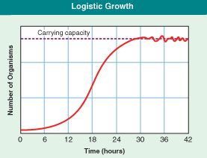

Slide 16
CARRYING CAPACITY

Slide 17
carrying capacity
The largest population of species that an environment can support.

Slide 18
carrying capacity
MATERIALS AND ENERGY
FOOD CHAINS
COMPETITION
DENSITY

Slide 19
1. MATERIALS AND ENERGY
- All populations of organisms are ultimately limited by the amount of usable energy from the sun and other essential materials such as water, carbon, etc.

Slide 20
2. food chains
-populations are limited to their food supply.
- Population sizes at any trophic level are limited by the population sizes in all the levels below.

Slide 21
3. competition
Each organism has the same needs as other organisms of its species
INTRASPECIFIC
-competition among members of the same species
INTERSPECIFIC
-competition between species

Slide 22
4. density
Different species have different needs of space.
POPULATION DENSITY
How many individuals can live in an area at one time.

Slide 23
Rate of population growth
(# births - # deaths ) + (# immigrants-#emigrants)
_____________________________________
total population
POPULATION EXPLOSION
- extreme fast growth of population

Slide 24
THE HUMAN POPULATION
doubled three times in the last three centuries
about 6.1 billion and may reach 9.3 billion by the year 2050
improved health and technology have lowered death rates
Notes:
Rapid growth after 10k years of slow growth. Estimates vary on current pop size as well as growth rate. Estimates of doubling time of 51 yrs.
Birth rate is not increasing, but death rate is decreasing. Antibiotics made a big difference. Exception: in European countries, demographic transition began around 1800. Triggered by ?

Slide 25
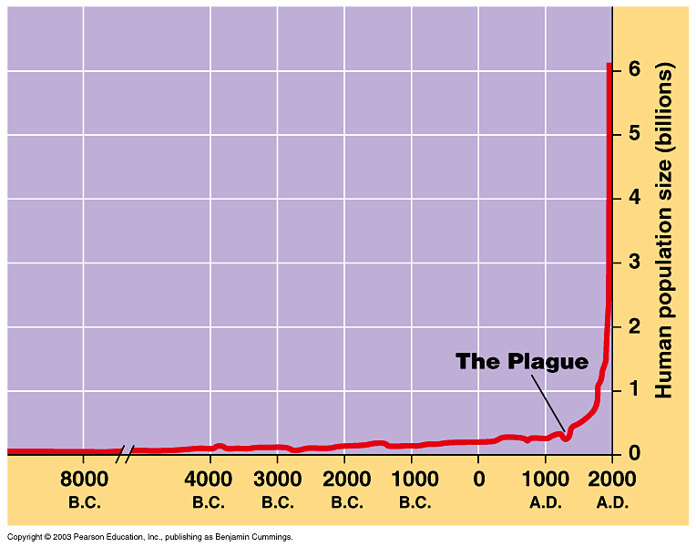
The history of human population growth
Figure 35.8A
Notes:
Resembles which model? Exponential
Agriculture provided stable food supply, about 10K years ago.
Expansion into different environments, allowed by uses of concentrated energy sources.
Note: depending on graph, can give different impression of these data. Change of scale on both axes can flatten this curve.

Slide 27
Age structure diagrams by country, 1997
What affects the fertility rate?

Slide 28
limitations
DENSITY-DEPENDENT
-Factors that increase in significance as a population grows.
Example:
Overcrowding

Slide 29
limitations
DENSITY-INDEPENDENT
-Factors that can limit population regardless of its size.
Example:
Forest fire

Slide 30
The loss of certain organisms can change the flow of energy in an ecosystem.

Slide 31
Issues:
Population is expanding, virtually uncontrolled. Population is harming other species.
The starling population in China or the global human population? What is your say?

Slide 32
Checkpoint!
List three characteristics that are used to describe a population.
What factors can change a population's size?
What is the difference between exponential growth and logistic growth?

Slide 33
Homework
Answer:
Check Your Understanding
# 1-6 on page 24.
QUIZ NEXT MEETING!!!!!

Slide 34
PRODUCTIVITY

Slide 35
PRODUCTIVITY
- The average amounts of new plant biomass produced each year per unit area.
Factors that influence productivity:
1) sunlight
2) water
3) carbon dioxide
4) area (geographical location)

Slide 36
FACTS ABOUT PRODUCTIVITY
1) Areas with low temperatures and little water have the lowest levels of productivity.
Deserts have abundant sunlight and warmth, but they lack water & minerals nutrients for plant growth.
Tropical forests are not always productive farmland.

Slide 37
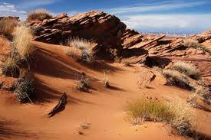
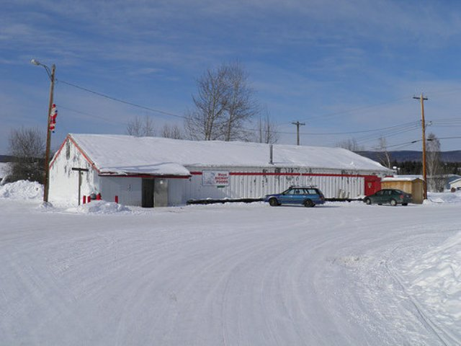
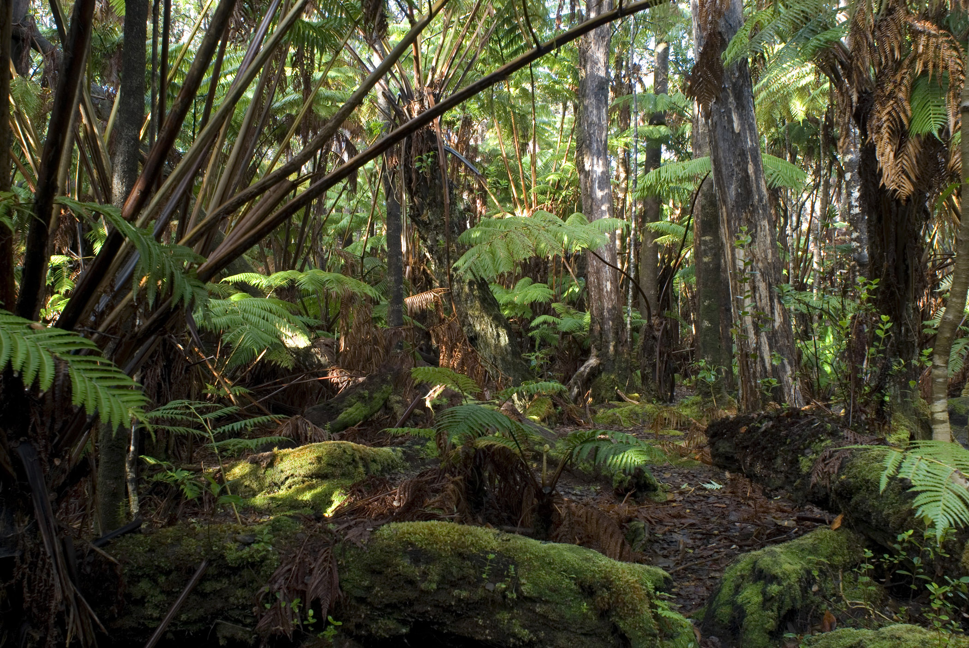
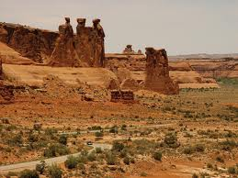
FACTS ABOUT PRODUCTIVITY

Slide 38
FACTS ABOUT PRODUCTIVITY
Farm plants & animals that are introduced from different parts of the world do not always survive well in new environments.
Careful use of irrigation and fertilizers could increase plant productivity and make some areas suitable for crop production.

Slide 39
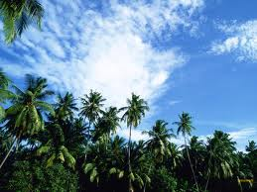
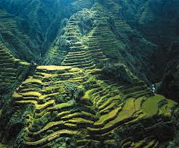
FACTS ABOUT PRODUCTIVITY

Slide 40
RELATIONSHIPS

Slide 41
FOOD AND POPULATION SIZE
What typical food a certain group of people eat?
Canadians eat more meat than most people.
Irish people eat mostly potatoes compared to rice.
What about Chinese?
The longer a food chain, the smaller the amount of sun’s energy that is available for humans at the end of the chain.

Slide 42
FOOD AND COMPETITORS
How do food chains in agricultural and natural ecosystems compare?
How might monoculture affect populations of primary consumers?
If there is an increase amount of producers, the population of primary consumers will increase in numbers quickly.

Slide 43
POISONS IN FOOD CHAINS
Please refer to the book entitled
“Toxins in Food Chains”
For more explanations, read your textbook (p. 29).

Slide 44
CONSUMING THE PLANET
Questions to ponder!
How much of Earth’s energy do people consume?
What effects does our use of energy have on other species that share the planet with us?
Read p. 33

Slide 45
Activity
DDT in a Food Chain
Work with a partner and perform Investigation 1-C on pages 30-32.
Read the DDT Story on page 31.
Answer the questions in page 32.

Slide 46
Homework
Answer:
Check Your Understanding
# 1-7 on page 34.
QUIZ NEXT MEETING!!!!!

