Slide 1
Chemical Reactions
Ms. Albarico

Slide 2



Students are expected to:
    Represent chemical reactions and the conservation of mass using molecular models, and balanced symbolic equations.

Slide 3
CHEMICAL REACTIONS
Reactants: Zn + I₂
Product: Zn I₂

Slide 4
Chemical Equations
Their Job: Depict the kind of reactants and products and their relative amounts in a reaction.
4 Al _{(s)} + 3 O_{2 (g)} ---> 2 Al₂O_{3 (s)}
The letters (s), (g), and (l) are the physical states of compounds.

Slide 5
Introduction
  Chemical reactions occur when bonds between the outermost parts of atoms are formed or broken.
  Chemical reactions involve changes in matter, the making of new materials with new properties, and energy changes.
  Symbols represent elements, formulas describe compounds, chemical equations describe a chemical reaction.

Slide 6
Parts of a Reaction Equation
  Chemical equations show the conversion of reactants (the molecules shown on the left of the arrow) into products (the molecules shown on the right of the arrow).
    A + sign separates molecules on the same side
    The arrow is read as “yields”
    Example
      C + O₂ → CO₂
    This reads “carbon plus oxygen react to yield carbon dioxide”.

Slide 7
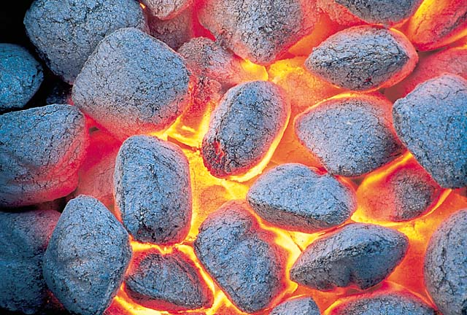
The charcoal used in a grill is basically carbon. The carbon reacts with oxygen to yield carbon dioxide. The chemical equation for this reaction, C + O₂ → CO₂, contains the same information as the English sentence but has quantitative meaning as well.

Slide 8
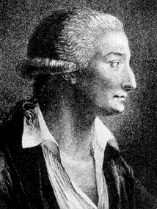
Chemical Equations
Because of the principle of the conservation of matter,
an equation must be balanced.
It must have the same number of atoms of the same kind on both sides.
Lavoisier, 1788

Slide 9
The Law of Conservation of Mass
The law of conservation of matter states that matter (mass) can neither be created nor destroyed. It can, however, can be rearranged.
In a chemical reaction, the mass of the reactants must equal the mass of the products.

Slide 10
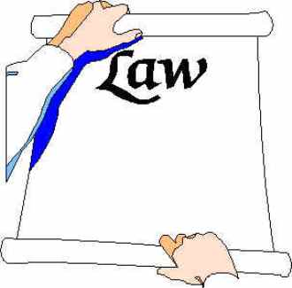
Thinking of the balance?
Everything must be equal!
When matter goes through a physical or chemical change, the amount (or mass) of the substances that you begin with must equal the amount (or mass) of the substances that you end with.
The before and after must balance.

Slide 11
Why, you ask?
It’s the Law!!!!
The Law of Conservation of Matter (Mass)
Matter can neither be created, nor destroyed.

Slide 12
Symbols Used in Equations
    Solid (s)
    Liquid (l)
    Gas (g)
    Aqueous solution (aq)
    Catalyst ^{H2SO4}
    Escaping gas (↑)
    Change of temperature (Δ)

Slide 13
Balancing Equations
  When balancing a chemical reaction, you may add coefficients in front of the compounds to balance the reaction, but you may not change the subscripts.
    Changing the subscripts changes the compound. Subscripts are determined by the valence electrons (charges for ionic or sharing for covalent).

Slide 14
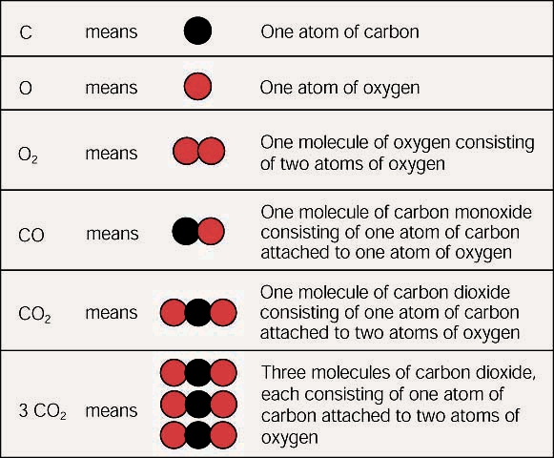
Subscripts vs. Coefficients
The subscripts tell you how many atoms of a particular element are in a compound. The coefficient tells you about the quantity, or number, of molecules of the compound.

Slide 15
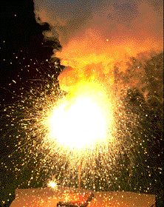
Chemical Equations
4 Al(s) + 3 O₂(g) ---> 2 Al₂O₃(s)
This equation means
4 Al atoms + 3 O₂ molecules ---produces--->
2 molecules of Al₂O₃
_{AND/OR}
4 moles of Al + 3 moles of O₂ ---produces-→ 2 moles of Al₂O₃

Slide 16
Steps to Balancing Equations
    Write the correct formula for the reactants and the products. DO NOT TRY TO BALANCE IT YET! You must write the correct formulas first. And most importantly, once you write them correctly DO NOT CHANGE THE FORMULAS!
    Find the number of atoms for each element on the left side. Compare those against the number of the atoms of the same element on the right side.
    Determine where to place coefficients in front of formulas so that the left side has the same number of atoms as the right side for EACH element in order to balance the equation.
    Check your answer to see if:
      The numbers of atoms on both sides of the equation are now balanced.
      The coefficients are in the lowest possible whole number ratios. (reduced)

Slide 17
Hints in Balancing Equations:
    Take one element at a time, working left to right except for H and O. Save H for next to last, and O until last.
    IF everything balances except for O, and there is no way to balance O with a whole number, double all the coefficients and try again. (Because O is diatomic as an element).
    (Shortcut) Polyatomic ions that appear on both sides of the equation should be balanced as independent units.

Slide 18
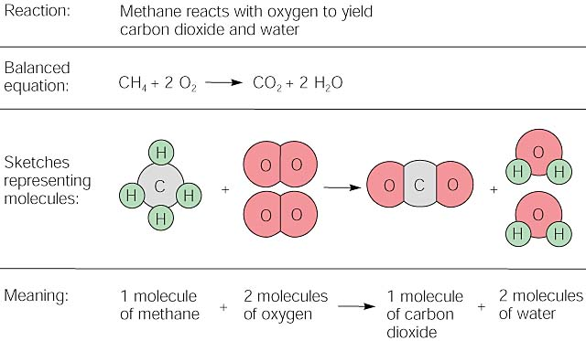

Slide 19
Balancing Equations
2
2
___ H₂(g) + ___ O₂(g) ---> ___ H₂O(l)
What Happened to the Other Oxygen Atom?????
This equation is not balanced!
Two hydrogen atoms from a hydrogen molecule (H₂) combines with one of the oxygen atoms from an oxygen molecule (O₂) to form H₂O. Then, the remaining oxygen atom combines with two more hydrogen atoms (from another H₂ molecule) to make a second H₂O molecule.

Slide 20
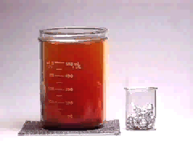
Balancing
Equations
2
3
___ Al(s) + ___ Br₂(l) ---> ___ Al₂Br₆(s)

Slide 21
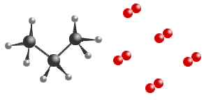
Balancing Equations
____C₃H₈(g) + _____ O₂(g) ----> _____CO₂(g) + _____ H₂O(g)
____B₄H₁₀(g) + _____ O₂(g) ---->
___ B₂O₃(g) + _____ H₂O(g)

Slide 22
Balancing Equations
Sodium phosphate + iron (III) oxide → sodium oxide + iron (III) phosphate
Na₃PO₄ + Fe₂O₃ ---->
Na₂O + FePO₄

Slide 23
Homework
Quiz Next Meeting!

