Slide 1
ECOLOGY
Science 10
Ms. Albarico

Slide 2
Sustainability

Slide 3
Students are expected to:
Identify examples where scientific understanding about an ecosystem was enhanced or revised as a result of human invention or related technologies (116-1)
Propose and defend a course of action on a multi-perspective social issue (118-9, 215-4, 118-5)
Communicate questions, ideas and intentions, and receive, interpret, understand support and respond to the ideas of others in preparing a report about ecosystem change (215-1)

Slide 4
SUSTAINABILITY
Means using materials from the environment that can eventually be broken down and returned.
Also means using only what is needed from the environment, always leaving enough for the resource to renew itself or to be replaced.

Slide 5
QUICK LOOK
As a student, what resources do you have right now that you can re-use again?
Look around your environment, is there anything that Chinese should do to have a sustainable lifestyle?

Slide 6
SUSTAINABLE DEVELOPMENT
- Development that incorporates the concept of using few resources wisely and recycling those resources over and over again so that the remaining resources are left for future generations to enjoy.

Slide 7
make a sustainable choice

Slide 8
class activity

Slide 9
Activity – What is Sustainability (Investigation 2-E)
Read your textbook (p. 67-68).
Materials :
colored pens, pencils
3) Follow the instructions given. Hand in your work after the class time.

Slide 10
Assignment Reminder

Slide 11
Video Design
1) Title
-must be brief and related to the topic
2) Topic
- it should be related all to environment
3) Materials
-what are the things you need to realize your ideas.

Slide 12
Video Checklist
Title
Scientific Facts
Information
Time Limit – (2-3 minutes)
Credits
Deadline – May 22, 2013

Slide 13
Homework
CYU # 1-6 on page 68.

Slide 14
CHANGE AND SUSTAINABILITY

Slide 15
Students are expected to:
Discover that the characteristics of soil affect plant growth.
Find out how soil, organisms, and climate continually interact to change the land over time.
Evaluate how human activities affect living communities.
Discover what is being done to protect Canadian ecosystems.
Learn how to use the resources of an area of land in a sustainable way.

Slide 16
THE IMPORTANCE OF SOIL
SOIL- the layer of material that covers the land and supports the growth of plants.
- A mixture of particles of weathered rock and decomposing plant and animal matter.
Characteristics of Soil:
1) Particle size 2) colour
3) Organic content 4) pH

Slide 17
Major Types of Soil in North America:
1) Grassland
2) Forest Soil
3) Desert Soil

Slide 18
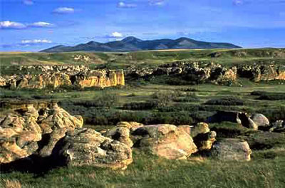
Grassland
- occurs naturally in areas with lower rainfall.

Slide 19
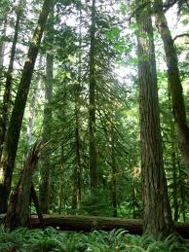
Forest Soil
develops in areas with more
precipitation (boreal forest)

Slide 20
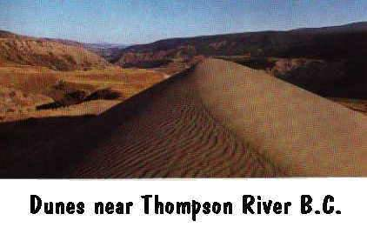
Desert Soil
has low levels of precipitation or nothing at all

Slide 21
Soil Organisms:
Soil fungi
Wood roach
Rove beetle
Snail
Slug
Millipede
Carpenter ant
Cicada nymph
Centipede
Earthworm
Mite
Wireworm
Springtail
Bug
Pseudoscorpion
Soil protozoans

Slide 22
Functions of Soil Organisms:
Breakdown animals wastes and dead plants into nutrients
Burrows the soil and make tunnels
Feed on plant roots
Open up spaces in the soil for air and the water to move through

Slide 23
DISTURBING SOIL
- NATURAL PHENOMENON:
Water/wind erosion, floods
Cyclonic storms
- HUMAN ACTIVITIES:
Logging, industrial pollution, pesticides

Slide 24
CHANGE AND SUCCESSION
SUCCESSION- one ecosystem is gradually replaced by another over a period of time.
PRIMARY SUCCESSION
-the sequence of changes that begins with a bare landscape and ends with a climax community
Pioneer Organisms- organisms that can live in such inhospitable places, without soil or shelter.

Slide 25
Example: Volcanic eruption
3 Most Important factors that determine where populations of people can live:
Soil type
Climate
Vegetation

Slide 26
Climax Community – a community of organisms that has a maximum amount of biomass for the environmental conditions of the area.
Lichens- are small organisms that are able to live and survive in conditions with little water or in rocks where few plants can survive.

Slide 27
SECONDARY SUCCESSION
A succession wherein it eventually restores a climax community
Causes:
Natural Events Human Activities
-Forest Fire -Building new houses
-Soil Erosion -Coal mines

Slide 28
The Impact of Change
Other areas can remain unproductive
Lost of species

Slide 29
UNDERSTANDING LAND USE

Slide 30
CHAPTER 3 SUMMARY CONCEPTS
BOGS require climate conditions that are extremely WET and COLD (to inhibit evaporation).
SPHAGNUM MOSS is the main component of peat.
Different soils have different characteristics. Soil can be acidic, neutral, or basic.

Slide 31
Soil differs from one area to another because the climatic conditions also vary. Differences in precipitation support different plant growth.
Climate conditions in Canada, unlike tropical conditions, it does not support growth throughout the year.
Forests in Canada experience extreme temperatures in winter and lower average annual rainfall. As a result, Canadian forests are not as diverse in organisms as tropical rainforests.

Slide 32
-REMEDIATION is the process in which an area is restored to its original condition.
-PHYTOREMEDIATION involves the use of the plants to remove toxins from the soil.
-The CANADIAN WILDERNESS CHARTER, which outlines nine goals for conserving wild places, was developed by several environmental organizations, including the WORLD WILDLIFE FUND, the CANADIAN PARKS AND WILDERNESS SOCIETY, and the ALGONQUIN WILDLANDS LEAGUE

Slide 33
Homework
Find at least 2 Chinese or Canadian organizations that advocates environmental awareness.
1) Who are they?
2) What do they do?
3) Do you think their goals are attainable? If not, explain.
4) What can you contribute?

