Slide 1
Chemical Reactions
Chapter 6
Ms. Albarico

Slide 2
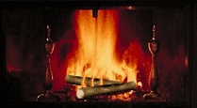
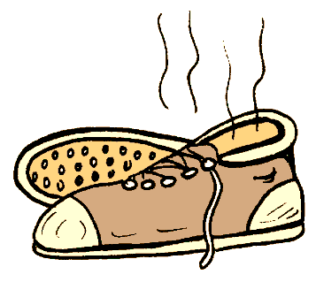
Indicators of chemical reactions:
Emission of light or heat
Formation of a gas
Formation of a precipitate
Color change
Emission of odor

Slide 3
All chemical reactions:
have two parts
Reactants - the substances you start with
Products- the substances you end up with
The reactants turn into the products.
Reactants → Products

Slide 4
Describing Chemical Reaction
The way atoms are joined is changed
Atoms can not be created nor destroyed.
BUT it can be described several ways.
In a sentence
Copper reacts with chlorine to form copper (II) chloride.
In a word equation
Copper + chlorine → copper (II) chloride
Cu_{(s)} + Cl_{2(g)} → CuCl_{2(aq)}

Slide 5
Formula Equation
Uses formulas and symbols to describe a reaction
doesn’t indicate how many.
All chemical equations are sentences that describe reactions.

Slide 6
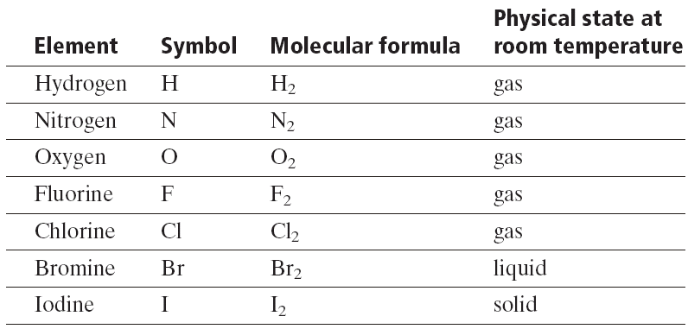
Diatomic elements
There are 7 elements that never want to be alone.
They form diatomic molecules.
H₂ , N₂ , O₂ , F₂ , Cl₂ , Br₂ , and I₂
The –ogens and the –ines

Slide 7
Convert this to an equation:
Solid iron (III) sulfide reacts with gaseous hydrogen chloride to form iron (II) chloride and hydrogen sulfide gas.
Fe₂S₃ _{(s)} + HCl_{(g)} → FeCl_{2 (s)} + H₂S_{(g)}

Slide 8
Convert this to an equation:
Nitric acid dissolved in water reacts with solid sodium carbonate to form liquid water and carbon dioxide gas and sodium nitrate dissolved in water.
HNO₃ _{(aq)} + Na₂CO_{3 (s)} → NaNO₃ _{(aq)} + H₂O_{(l)} + CO_{2(g)}

Slide 9
The other way:
Fe_{(s)} + O_{2(g)} → Fe₂O_{3(s)}
Solid iron reacts with oxygen gas to form solid iron oxide (rust).

Slide 10
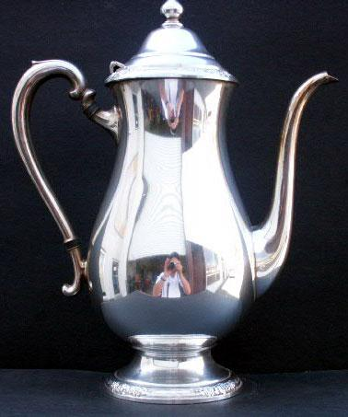
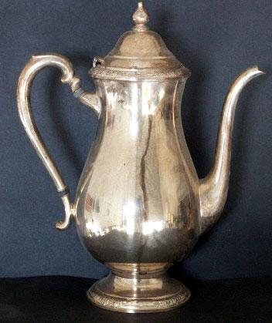
A silver spoon tarnishes. The solid silver reacts with sulfur in the air to make solid silver sulfide, the black material we call tarnish.
Ag _{(s)} + H₂S _{(g)} + O₂ _{(g)} → Ag₂S _{(s)} + H₂O

Slide 11
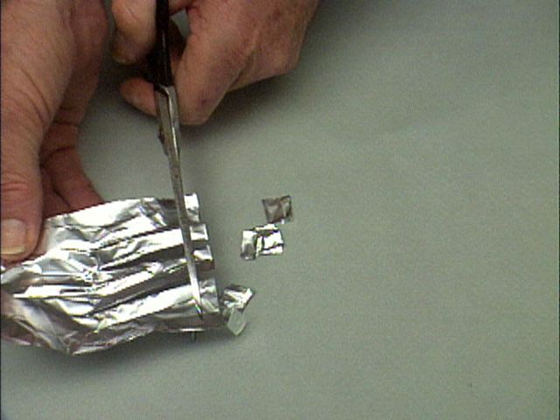

Slide 12
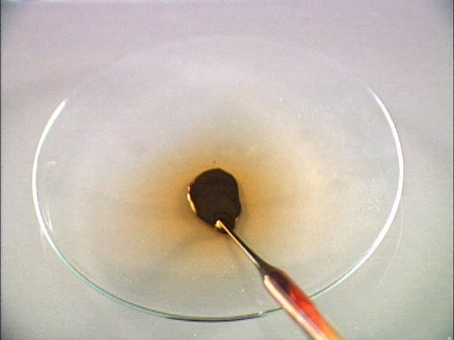

Slide 13
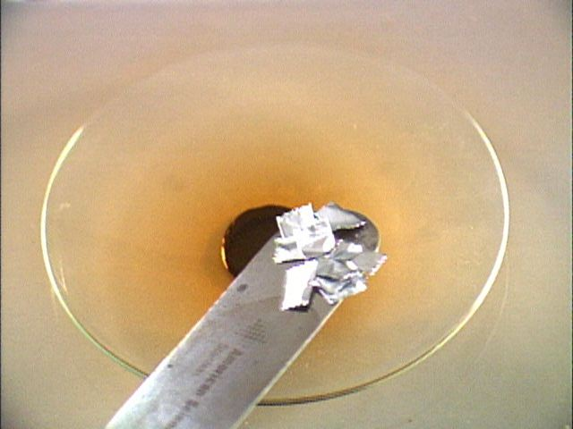

Slide 14
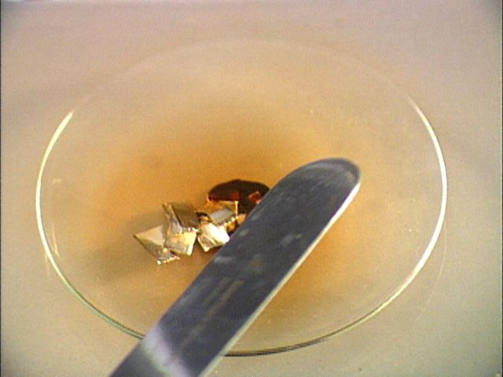

Slide 15
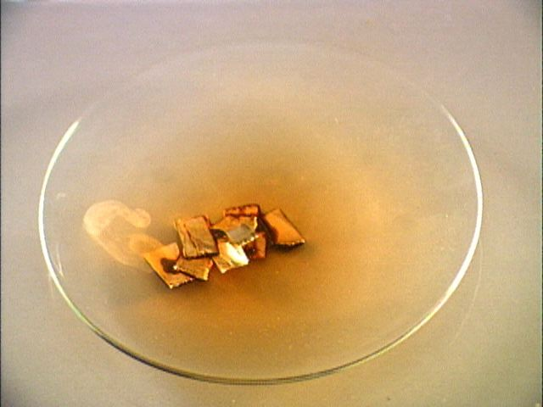

Slide 16
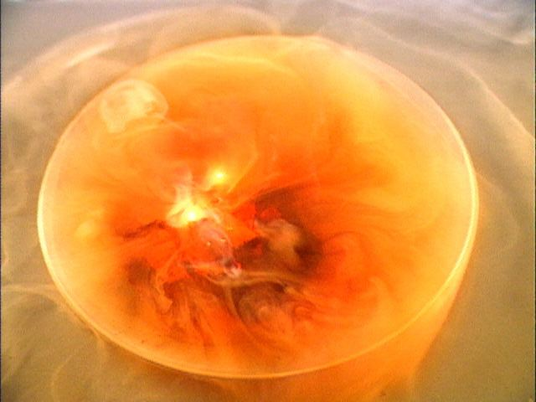

Slide 17
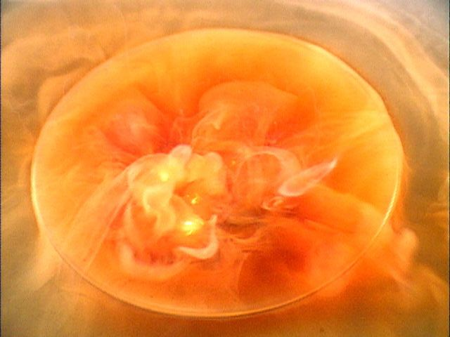

Slide 18
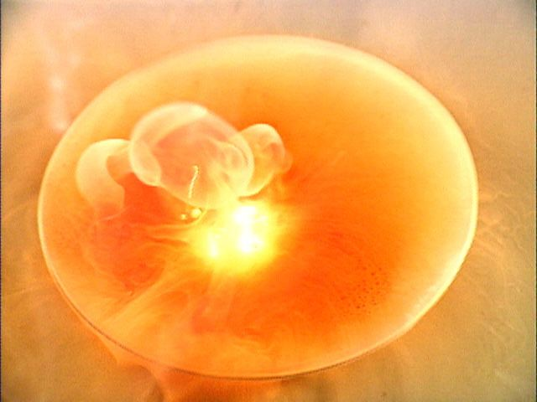

Slide 19
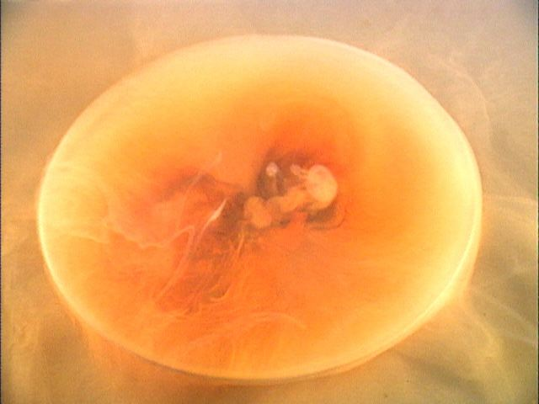

Slide 20
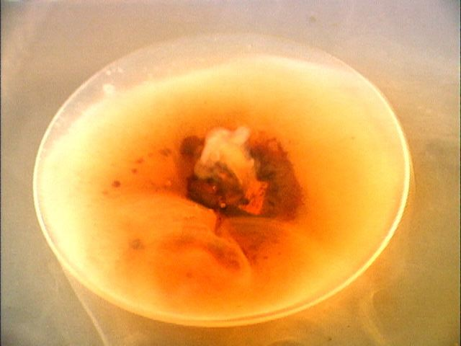

Slide 21
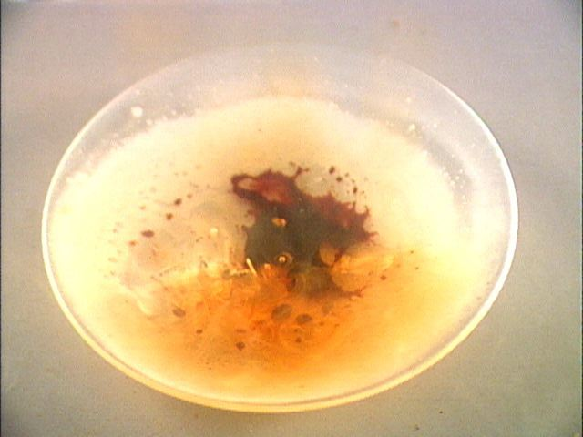

Slide 22
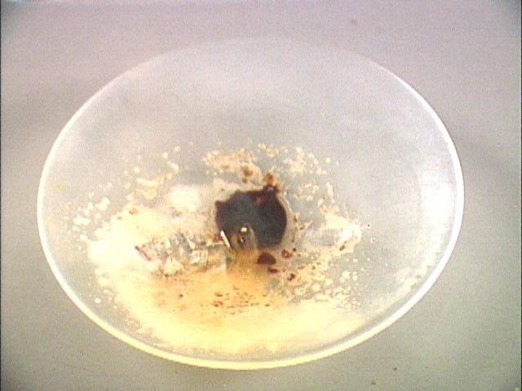

Slide 23
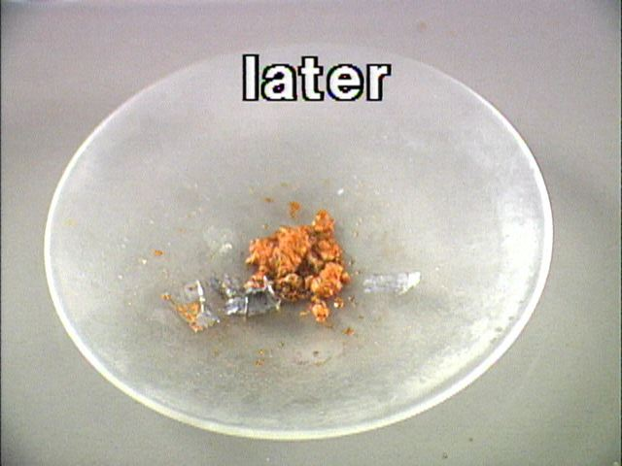

Slide 24
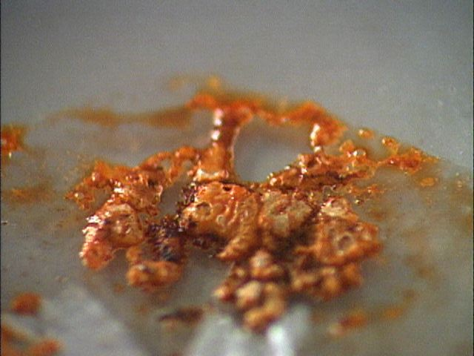

Slide 25
Translate Equation
Aluminum metal reacts with liquid bromine to form solid aluminum bromide
___ Al(s)
3
2
2
+ ___ Br₂(l)
→___ AlBr₃(s)

Slide 26
Translate some more!
calcium fluoride and sulfuric acid make calcium sulfate and hydrofluoric acid
calcium carbonate will come apart when you heat it to leave calcium oxide and carbon dioxide.
ammonia gas when it is pressed into water will make ammonium hydroxide.
aluminum sulfate and calcium hydroxide become aluminum hydroxide and calcium sulfate.
copper metal and silver nitrate react to form silver metal and copper (II) nitrate.
sodium metal and chlorine react to make sodium chloride.

Slide 27
Types of Reactions
There are millions of reactions.
Can’t remember them all
Fall into several categories.
We will learn 6 types.
We will be able to predict the products.
For some we will be able to predict whether they will happen at all.
We will recognize them by the reactants

Slide 28
Reaction Energy
All chemical reactions are accompanied by a change in energy.
Exothermic - reactions that release energy to their surroundings (usually in the form of heat)
ΔH (enthalpy) is negative – energy leaving system
Endothermic - reactions that need to absorb heat from their surroundings to proceed.
ΔH (enthalpy) is positive – energy coming into the system

Slide 29
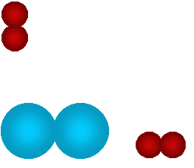
1) Synthesis Reactions
Also called combination reactions.
2 elements, or compounds combine to make one compound.
A + B → AB
Na _{(s)} + Cl_{2 (g)} → NaCl _{(s)}
Ca _{(s)} +O_{2 (g)} → CaO _{(s)}
SO_{3 (s)} + H₂O _{(l)} → H₂SO_{4 (s)}
We can predict the products if they are two elements.
Mg _{(s)} + N_{2 (g)} →
Mg₃N₂ _{(s)}

Slide 30
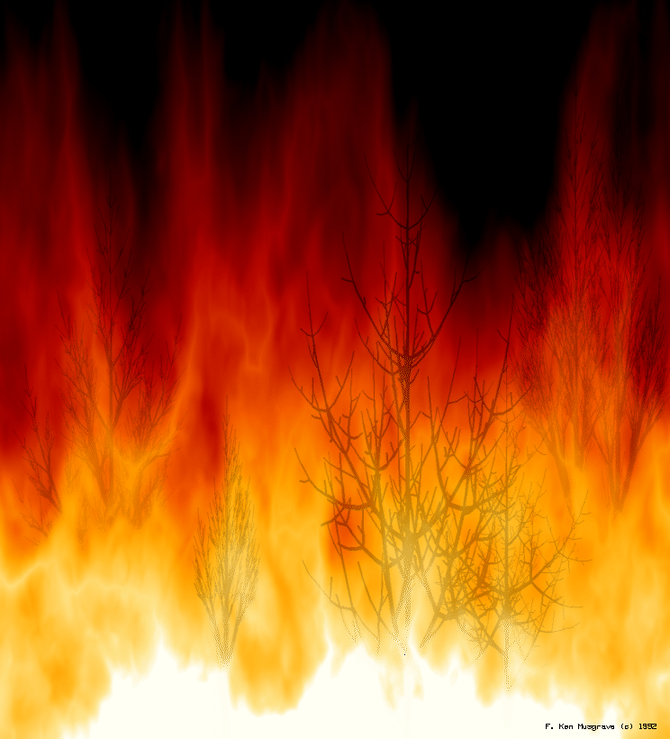
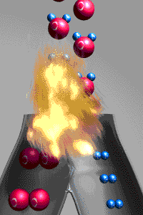
A simulation of the reaction: 2H₂ + O₂ → 2H₂O

Slide 31
2) Decomposition Reactions
decompose = fall apart
one compound (reactant) falls apart into two or more elements or compounds.
Usually requires energy
AB → A + B
NaCl Na + Cl₂
CaCO₃ CaO + CO₂

Slide 32
Decomposition Reactions
Can predict the products if it is a binary compound .
Made up of only two elements
Falls apart into its elements
H₂O
HgO
H₂ _{(g)} + O₂ _{(g)}
Hg _{(s)} + O₂ _{(g)}

Slide 33
Decomposition Reactions
If the compound has more than two elements you must be given one of the products
The other product will be from the missing pieces
NiCO₃ _{(aq)}
H₂CO_{3(aq)} →
CO₂ _{(g)}
+ Ni _{(s)}
H₂ _{(g)}
+ CO₂ _{(g)}

Slide 34
3) Single Replacement
Also referred to as single displacement.
One element replaces another
Reactants must be an element and a compound.
Products will be a different element and a different compound.
A + BC → AC + B
2Na + SrCl₂ → Sr + 2NaCl
F₂ + LiCl → LiF + Cl₂

Slide 35
Single Replacement
We can tell whether a reaction will happen
Some are more active than other
More active replaces less active

Slide 36
4) Double Replacement
Two things replace each other.
Reactants must be two ionic compounds or acids.
Usually in aqueous solution
AB + CD → AD + CB
ZnS + 2HCl →
ZnCl + H₂S
AgNO₃ + NaCl →
AgCl + NaNO₃

Slide 37
5) Combustion
A reaction in which a compound (often carbon) reacts with oxygen
CH₄ + O₂ → CO₂ + H₂O
C₃H₈ + O₂ → CO₂ + H₂O
C₆H₁₂O₆ + O₂ → CO₂ + H₂O

Slide 38
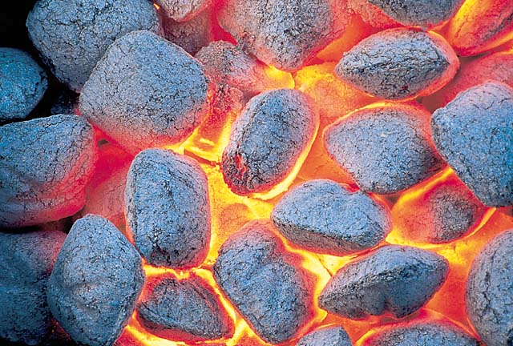
The charcoal used in a grill is basically carbon. The carbon reacts with oxygen to yield carbon dioxide. The chemical equation for this reaction is C + O₂ → CO₂

Slide 39
6) Acid/Base Reaction
An acid and a base react to form a salt and water.
Always in aqueous solution
Acid (H⁺) + Base (OH⁻) → Salt + H₂O
NaOH + HCl → NaCl + H₂O
NH₄OH + H₂SO₄ → (NH₄)₂SO₄ + H₂O

Slide 40
How to recognize which type of chemical reaction?
Look at the reactants
Element(E), Compound(C)
E + E
C
E + C
C + C
Acid + Base
Look at the Products
CO₂ + H₂O
Synthesis
Decomposition
Redox
Single replacement
Double replacement
Acid/Base reaction
Combustion

Slide 41
Examples
H₂ + O₂ →
Synthesis
H₂O →
Decomposition
AgNO₃ + NaCl →
Double replacement
Zn + H₂SO₄ →
Single replacement
HgO →
Decomposition
KBr +Cl₂ →
Single replacement
Mg(OH)₂ + H₂SO₃ →
Double replacement

Slide 42
Examples
HNO₃ + KOH →
Acid/Base
CaPO₄ →
Decomposition
AgBr + Cl₂ →
Single replacement
Zn + O₂ →
Synthesis
HgO + Pb→
Single replacement
HBr + NH₄OH →
Acid/Base
Cu(OH)₂ + KClO₃ →
Double replacement

Slide 43
Summary
An equation:
* Describes a reaction.
* Must be balanced because to follow Law of Conservation of Energy.
* Can only be balanced by changing the coefficients.
* Has special symbols to indicate state, and if catalyst or energy is required.
* Can describe different types of reactions.

