Slide 1
ACIDS AND BASES
Chemistry 10
Ms. Albarico

Slide 2
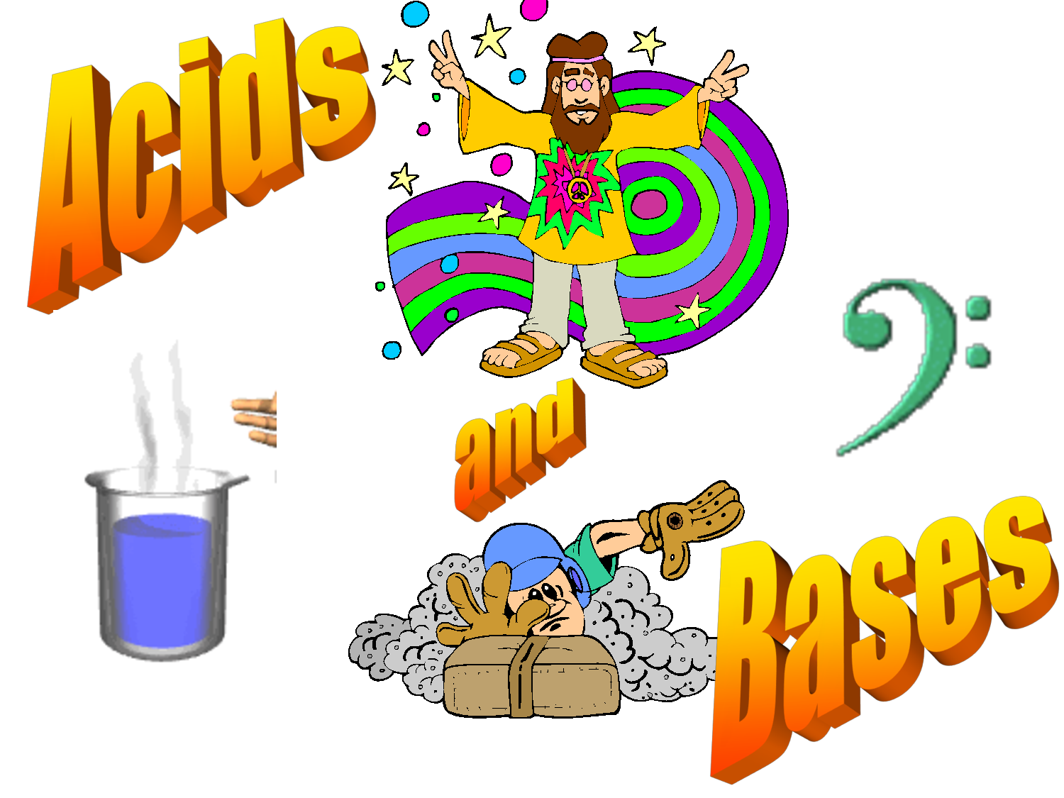

Slide 3
Students are expected to:
    Classify simple acids, bases and salts based on their name and formula;
    Evaluate and select appropriate instruments for collecting evidence and appropriate processes for problem solving, inquiring, and decision-making by investigating the properties of acids, bases and salts;
    Classify substances as acids, bases, or salts, based on their characteristic properties; and
    Describe how neutralization involves tempering the effects of an acid with a base and vice-versa.

Slide 4
Vocabulary
solvent
solute
electrolyte
corrode, corrosive
ions
hyperacidity
conjugate
dissociate, associate

Slide 5
Definitions
Acids – produce H⁺
Bases - produce OH⁻
Acids – donate H⁺
Bases – accept H⁺
Acids – accept e⁻ pair
Bases – donate e⁻ pair
Arrehenius
only in water
Bronsted-Lowry
any solvent
Lewis
used in organic chemistry, wider range of substances

Slide 6
Examples
The hydrogen ion in aqueous solution
H⁺ + H₂O → H₃O⁺ (hydronium ion)
Arrhenius
HCl
NaOH
Bronsted-Lowry
HCl
HCN
NH₃
Lewis
BF₃
:NH₃

Slide 7
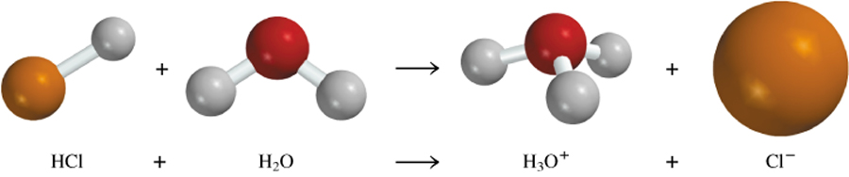
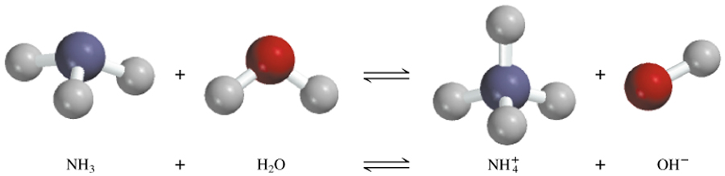
1. Arrhenius Definition
Arrhenius acid is a substance that produces H⁺ (H₃O⁺) in water
Arrhenius base is a substance that produces OH⁻ in water
4.3

Slide 8
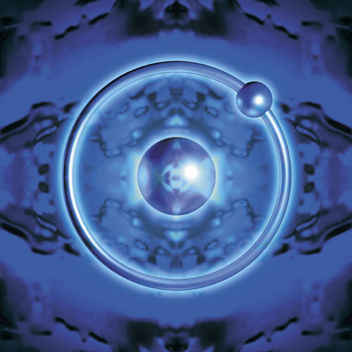
2. Brønsted – Lowry Definition
  Acids – proton donor
  Bases – proton acceptor
  A “proton” is really just a hydrogen atom that has lost it’s electron!

Slide 9
A Brønsted-Lowry acid is a proton donor
A Brønsted-Lowry base is a proton acceptor
conjugate acid
conjugate base
base
acid

Slide 10
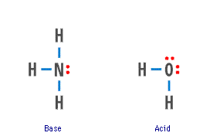
The Brønsted definition means NH₃ is a BASE in water — and water is itself an ACID

Slide 11
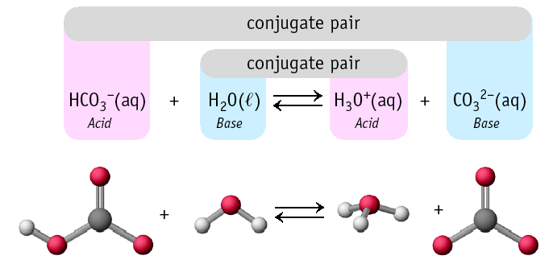
Conjugate Pairs

Slide 12
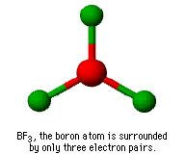
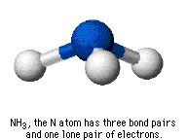
3. Lewis Definition
Lewis Acid - a substance that accepts an electron pair
Lewis Base - a substance that donates an electron pair

Slide 13
Formation of hydronium ion is also an excellent example.
Electron pair of the new O-H bond originates on the Lewis base.

Slide 14
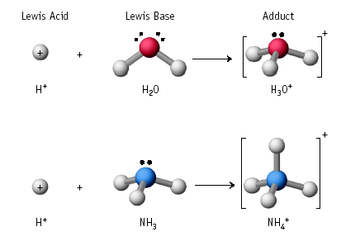
Lewis Acid/Base Reaction

Slide 15
General Properties
ACIDS
Taste sour
Turn litmus
React with active metals – Fe, Zn
React with bases
BASES
Taste bitter
Turn litmus
Feel soapy or slippery (react with fats to make soap)
React with acids
blue to red
red to blue

Slide 16
Common Characteristics Of Acids
Acids can be characterized by:
A sour taste.
It turns blue litmus paper red
It tastes sour. Try drinking lemon juice (citric acid)

Slide 17
Other Properties of Acids
Produce H⁺ (as H₃O⁺) ions in water (the hydronium ion is a hydrogen ion attached to a water molecule)
Taste sour
Corrode metals
Electrolytes
React with bases to form a salt and water
pH is less than 7
Turns blue litmus paper to red “Blue to Red A-CID”

Slide 18
Acid Nomenclature Review
No Oxygen→
w/Oxygen
An easy way to remember which goes with which…
“In the cafeteria, you ATE something ICky”

Slide 19
Common Characteristics of Bases
A Base is characterized by:
A bitter taste. (Milk of Magnesia)
It feels slippery. (Soapy Water)
It turns Red Litmus Blue.

Slide 20
Other Properties of Bases
Produce OH⁻ ions in water
Taste bitter, chalky
Are electrolytes
Feel soapy, slippery
React with acids to form salts and water
pH greater than 7
Turns red litmus paper to blue “Basic Blue”

Slide 21
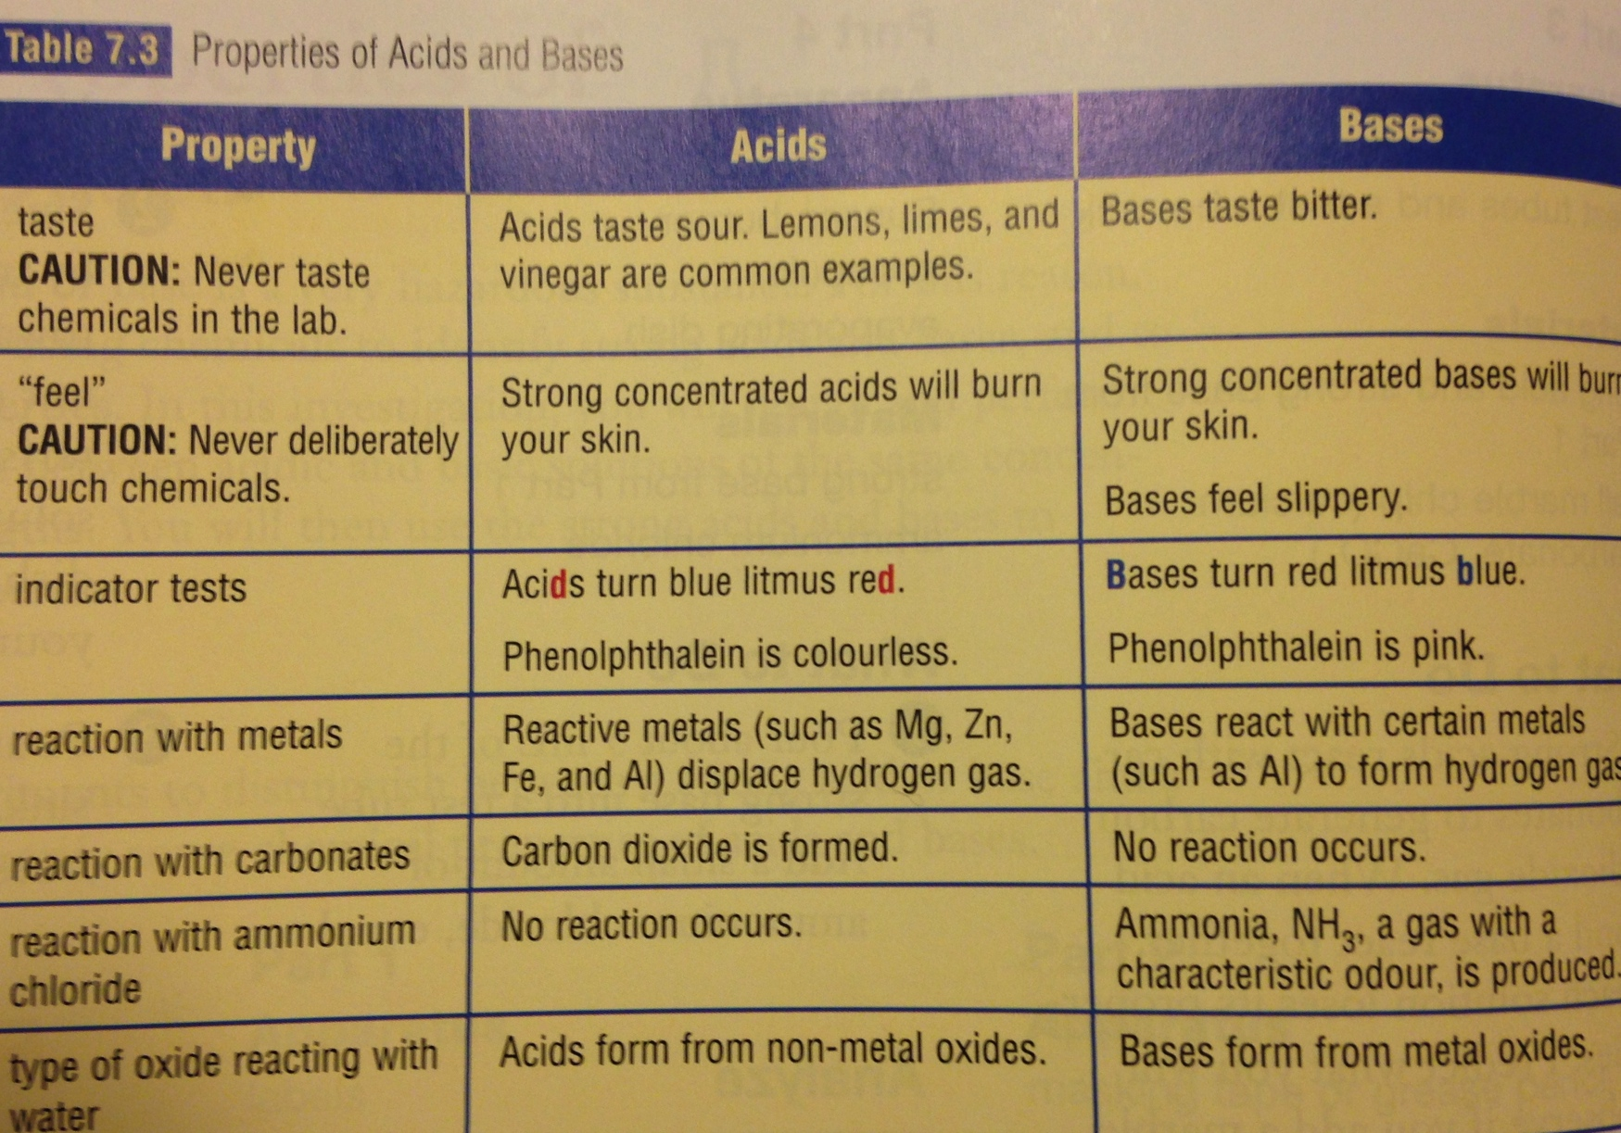

Slide 22
The Oxides of Elements
OXIDE – a compound that consists of an element combined with only oxygen.
Examples:
CO, CO₂, Al2O₃
Can we consider H₂SO₄ and HNO₃ oxides?

Slide 23
Identifying Acids and Bases
Acids have a ph from 0-7
Lower pH value indicates a stronger acid
Bases have a pH from 7-14
Higher pH value indicates a stronger base.

Slide 24
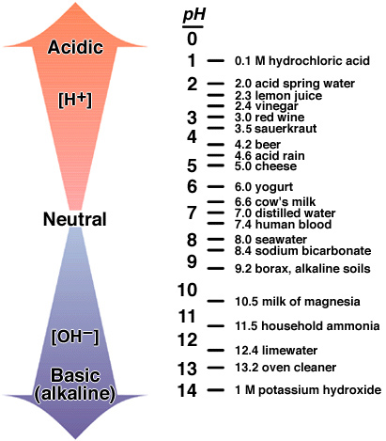
What is the pH scale?
The pH scale measures how acidic or basic a solution is.

Slide 25
The pH scale
The pH scale is the concentration of hydrogen ions in a given substance.

Slide 26
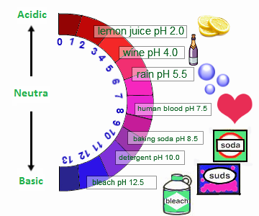

Slide 27
pH
0-14 scale for the chemists
2
3
4
5
6
7
8
9
10
11
12
acidic
(H⁺) > (OH⁻)
neutral @ 25ºC
(H⁺) = (OH⁻)
distilled water
basic or alkaline
(H⁺) < (OH⁻)
normal rain (CO₂)
pH = 5.3 – 5.7
fish populations
drop off pH < 6 and to zero pH < 5
natural waters pH = 6.5 - 8.5

Slide 28
An INDICATOR is a chemical that changes colour as the concentration of H⁺ or OH⁻ changes.
The most common indicator is LITMUS. Litmus is a compound that is extracted from lichens.
You can determine the pH level of a substance by placing a drop of the solution on a litmus paper. The color of the litmus paper will tell you the level of the acid and base in a substance.

Slide 29
Today’s Experiment
1) Test the pH of the following:
Pepsi, Coke, Sprite
3 different brands of drinking water
3 different fruits
3 liquid soaps
blood, river water, tap water
2) Record your data in a table. Estimate the pH level using the universal pH paper. Classify if it an acid or a base.

Slide 30
Chemistry Lab
Perform Investigation 7-C
To bring(by group):
2 red cabbage
lemon juice
vinegar, milk of magnesia or antacid tablet
rain water, distilled water
liquid soap, shampoo
house hold ammonia
club soda, clean drinking straw, 10 plastic cups

Slide 31
Strong and Weak Acids/Bases
Strong acids/bases – 100% dissociation into ions
HCl NaOH
HNO₃ KOH
H₂SO₄
Weak acids/bases – partial dissociation, both ions and molecules
CH₃COOH NH₃

Slide 32
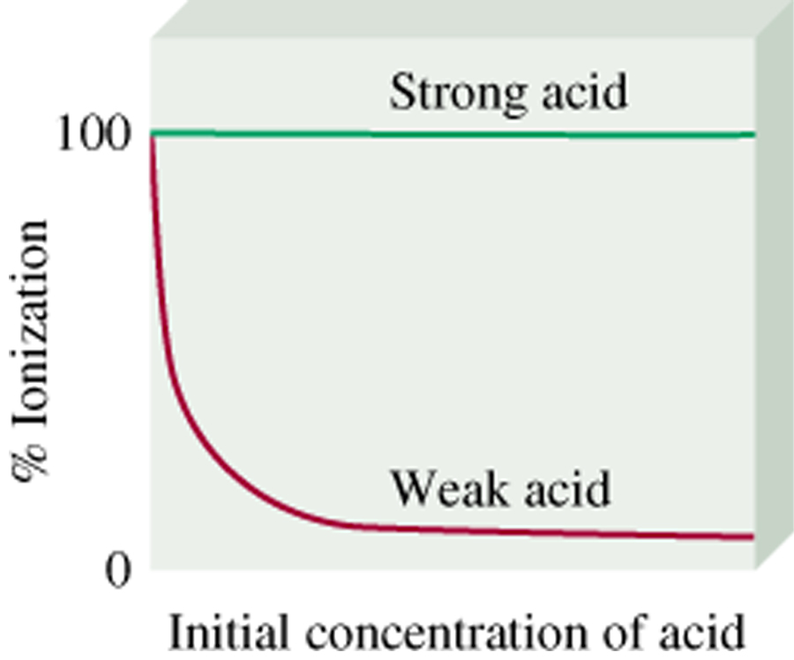
Ionized acid concentration at equilibrium
percent ionization =
x 100%
Initial concentration of acid
It refers to the number of molecules that will ionize for every 100
molecules that dissolve.
[H⁺]
Percent ionization =
x 100%
[HA]₀ = initial concentration
[HA]₀

Slide 33
Why Learn about Acids & Bases?
What do you think is the pH level of NC tap water?
The pH of a swimming pool must be checked periodically. Why?
Is it important for lakes & rivers to maintain a certain pH?

Slide 34
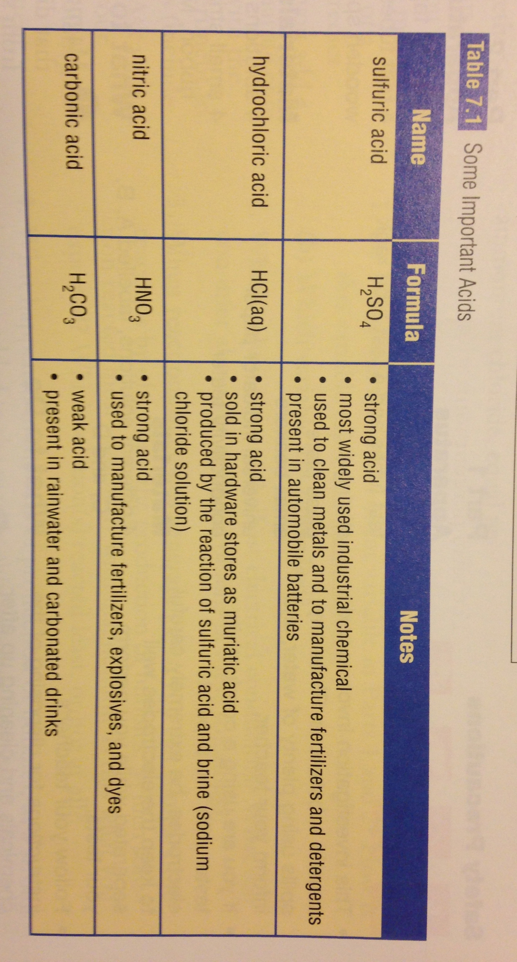

Slide 35
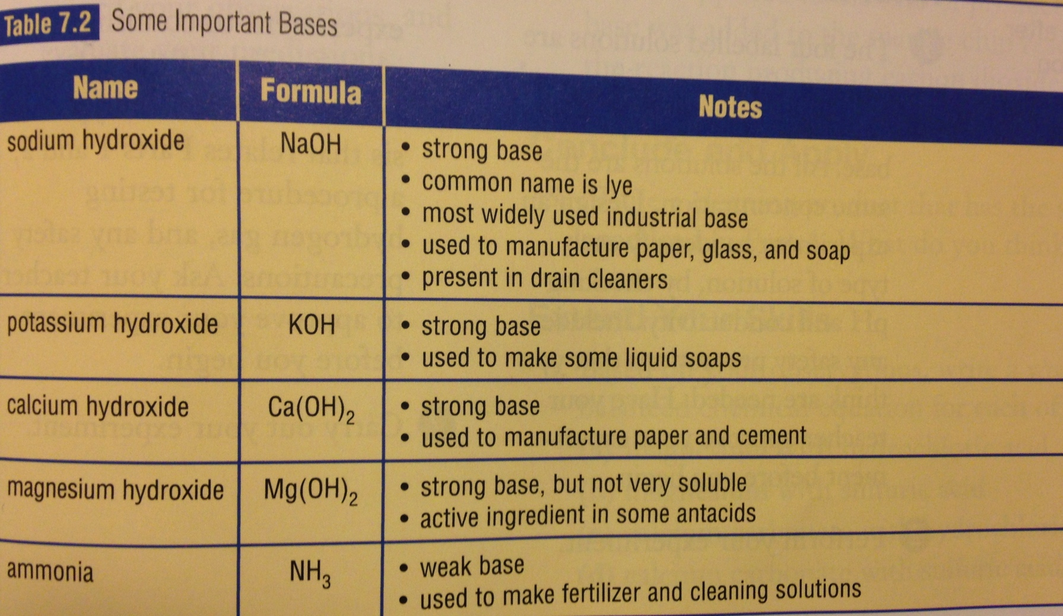

Slide 36
Neutralization
In general:
Acid + Base → Salt + Water
All neutralization reactions are double displacement reactions.
HCl + NaOH → NaCl + HOH
HCl + Mg(OH)₂ →
H₂SO₄ + NaHCO₃ →

Slide 37
Think about?
When a person has hyperacidity, what medicine he has to take and why?

Slide 38
Research Report
Find any English articles online that features about acid rain. Print it in an A4 paper.
Write an article about why acid rain is dangerous to the environment and convince people to listen to you. Advocate environmental awareness.

Slide 39
What is an acid rain?
Dissolved carbon dioxide lowers the pH
CO₂ (g) + H₂O  H₂CO₃  H⁺ + HCO₃⁻
Atmospheric pollutants from combustion
NO, NO₂ + H₂O … → HNO₃
both
strong
acids
SO₂, SO₃ + H₂O … → H₂SO₄
pH < 5.3

Slide 40
Chemistry Lab
Perform Inv. 7-D (Except Part 2)

Slide 41
Homework
Chapter 7 Review

Slide 42
Weblinks
http://chemistry.tutorvista.com/inorganic-chemistry/acids-bases-and-salts.html

