Slide 1
Chemistry
Chapter 5
Ms. Lilian Albarico

Slide 2
Students are expected to:
Name and write formulas for common molecular compounds, including the use of prefixes
Name and write formulas for some common ionic compounds (both binary and complex) using the periodic table, a list of ions and appropriate nomenclature for metal and non-metal ions
Describe the usefulness of IUPAC scientific nomenclature systems to convey chemical information

Slide 4
Types of BONDING
IONIC BOND
MOLECULAR BOND
METALLIC BOND

Slide 5
IONIC BOND bond formed between two ions by the transfer of electrons

Slide 6
Formation of Ions from Metals
Ionic compounds result when metals react with nonmetals
Metals lose electrons to match the number of valence electrons of their nearest noble gas
Positive ions form when the number of electrons are less than the number of protons
Group 1 metals ⎯→ ion ¹⁺
Group 2 metals ⎯→ ion ²⁺
Group 13 metals ⎯→ ion ³⁺

Slide 7
Ionic Bond
Between atoms of metals and nonmetals with very different electronegativity
Bond formed by transfer of electrons
Produce charged ions all states. Conductors and have high melting point.
Examples; NaCl, CaCl₂, K₂O

Slide 8
Properties of Ionic Compounds
Ionic compounds tend to have relatively high melting points because a large amount of energy is needed to break the strong forces of attraction in ionic compounds.
Ionic Compounds conduct electricity when they are molten or when they are dissolved in water. This is because melting or dissolving allows the ions to move freely.
Ionic compounds in the solid state are not electrical conductors; the ions are not able to move.
Ionic substances tend to be electrolytes. An ELECTROLYTE is a substance that dissolves in the water to produce a solution that conducts electricity.

Slide 9
Formation of Sodium Ion
Sodium atom Sodium ion
Na • – e⁻ ⎯⎯→ Na ⁺
2-8-1 2-8 ( = Ne)
11 p⁺ 11 p⁺
11 e⁻ 10 e⁻
0 1⁺

Slide 10
Formation of Magnesium Ion
Magnesium atom Magnesium ion
•
Mg • – 2e⁻ ⎯→ Mg²⁺
2-8-2 2-8 (=Ne)
12 p⁺ 12 p⁺
12 e- 10 e⁻
0 2⁺

Slide 11
Some Typical Ions with Positive Charges (Cations)
Group 1 Group 2 Group 13
H⁺ Mg²⁺ Al³⁺
Li⁺ Ca²⁺
Na⁺ Sr²⁺
K⁺ Ba²⁺

Slide 12
Learning Check
A. Number of valence electrons in aluminum
1) 1 e⁻ 2) 2 e⁻ 3) 3 e⁻
B. Change in electrons for octet
1) lose 3e⁻ 2) gain 3 e⁻ 3) gain 5 e⁻
C. Ionic charge of aluminum
1) 3- 2) 5- 3) 3⁺

Slide 13
Solution
A. Number of valence electrons in aluminum
3) 3 e⁻
B. Change in electrons for octet
1) lose 3e⁻
C. Ionic charge of aluminum
3) 3⁺

Slide 14
Learning Check
Give the ionic charge for each of the following:
A. 12 p⁺ and 10 e⁻
1) 0 2) 2+ 3) 2-
B. 50p⁺ and 46 e-
1) 2+ 2) 4+ 3) 4-
C. 15 p⁺ and 18e-
2) 3+ 2) 3- 3) 5-

Slide 15
Ions from Nonmetal Ions
In ionic compounds, nonmetals in 15, 16, and 17 gain electrons from metals
Nonmetal add electrons to achieve the octet arrangement
Nonmetal ionic charge:
3-, 2-, or 1-

Slide 16
Fluoride Ion
unpaired electron octet
• • • • 1 -
: F • + e⁻ : F :
• • • •
2-7 2-8 (= Ne)
9 p+ 9 p⁺
9 e- 10 e-
0 1 -
ionic charge

Slide 17
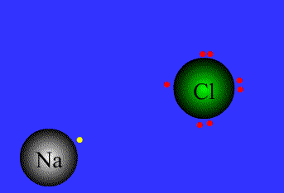

Slide 18
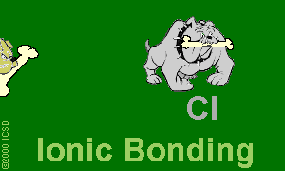
Ionic Bonds: One Big Greedy Thief Dog!

Slide 19
1). Ionic bond – electron from Na is transferred to Cl, this causes a charge imbalance in each atom. The Na becomes (Na+) and the Cl becomes (Cl-), charged particles or ions.

Slide 20
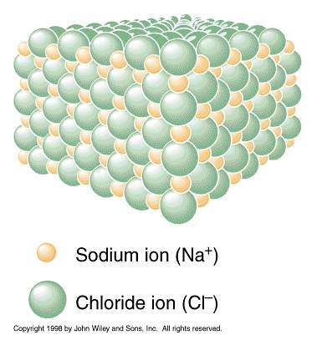

Slide 21
COVALENT BOND bond formed by the sharing of electrons

Slide 22
Covalent Bond
Between nonmetallic elements of similar electronegativity.
Formed by sharing electron pairs
Stable non-ionizing particles, they are not conductors at any state
Examples; O₂, CO₂, C₂H₆, H₂O, SiC

Slide 23
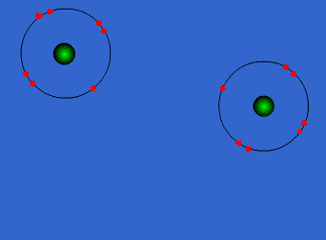
Covalent Bonds

Slide 24
Properties of Molecular Compounds
Molecular compounds have relatively low melting points because little energy is needed to break the forces of attraction between molecules.
Molecular compounds tend not to conduct electricity when they are in the solid or liquid state, or when they are dissolved in water, because they do not contain ions.

Slide 25
Bonds in all the polyatomic ions and diatomics are all covalent bonds

Slide 26
when electrons are shared equally
NONPOLAR COVALENT BONDS
H₂ or Cl₂

Slide 27
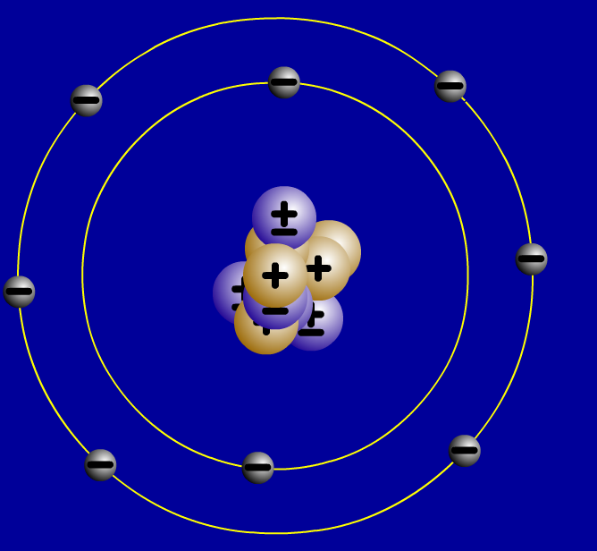
2. Covalent bonds- Two atoms share one or more pairs of outer-shell electrons.
Oxygen Atom
Oxygen Atom
Oxygen Molecule (O₂)

Slide 28
when electrons are shared but shared unequally
POLAR COVALENT BONDS
H₂O

Slide 29
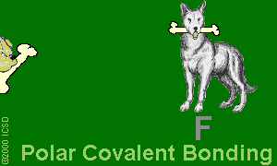
Polar Covalent Bonds: Unevenly matched, but willing to share.

Slide 30
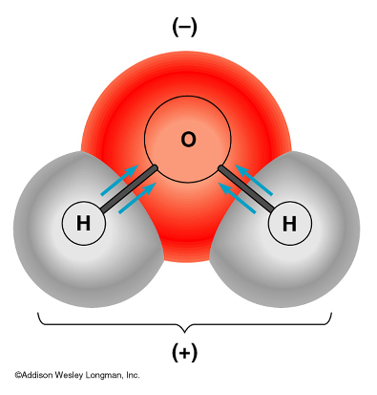
- water is a polar molecule because oxygen is more electronegative than hydrogen, and therefore electrons are pulled closer to oxygen.

Slide 31
METALLIC BOND bond found in metals; holds metal atoms together very strongly

Slide 32
Properties of Metallic Bond
Formed between atoms of metallic elements.
Electron cloud around atoms.
Good conductors at all states, lustrous, very high melting points.
Good conductors of electricity because they are composed of a sea of electrons.
Examples; Na, Fe, Al, Au, Co

Slide 33
Metallic Bonds: Mellow dogs with plenty of bones to go around.

Slide 34
Ionic Bond, A Sea of Electrons

Slide 35
Metals Form Alloys
Metals do not combine with metals. They form
Alloys which is a solution of a metal in a metal.
Examples are steel, brass, bronze and pewter.

Slide 36
Practice
Compute the mass of the following compounds round to nearest tenth & state type of bond:
NaCl;
23 + 35 = 58; Ionic Bond
C₂H₆;
24 + 6 = 30; Covalent Bond
Na(CO₃)₂;
23 + 2(12 + 3x16) = 123; Ionic & Covalent

