Slide 1
Chemistry
Chapter 5
Ms. Lilian Albarico

Slide 2
Students are expected to:
Name and write formulas for common molecular compounds, including the use of prefixes.
Name and write formulas for some common ionic compounds (both binary and complex) using the periodic table, a list of ions and appropriate nomenclature for metal and non-metal ions.

Slide 3
Naming of Compounds
BINARY IONIC compounds
MOLECULAR compounds

Slide 4
A BINARY IONIC COMPOUND is composed of ions of one metal element and ions of one non-metal element grouped together in a structure.

Slide 5
Rules in forming Binary Ionic Compound:
1) The first element in the name is metal. For example, use the name sodium to name the metal in NaCl. Use the name Calcium to name the metal in CaCl₂.
2) The second element, the non-metal, is named as an ion. In other words, the suffix “-ide” is attached to the name. For example, use chloride to name the non-metal in NaCl and CaCl₂.
3) Put the parts of the name together. For example, NaCl is called sodium chloride, and CaCl₂ is named calcium chloride.

Slide 6
Two Ways to Name Cations:
1) The Stock System – This system was devised by the German chemist Alfred Stock. It uses Roman numerals to indicate the charge of the metal cation. Place Roman numerals in brackets after the name of the first element.
Example:
Copper (II) oxide = CuO Copper (I) oxide = Cu₂O
2) The Classical System – In this system, it uses the suffix –ic to indicate the metal with the greater charge and the suffix –ous to indicate the metal ion with the smaller charge. Other elements are named after their Latin names.
Example:
FeO = Ferrous Oxide FeCl₃ = Ferric Chloride

Slide 7
List of Elements (in Latin)
Element Symbol Latin Name
Antimony Sb Stibium
Copper Cu Cuprum
Gold Au Aurum
Iron Fe Ferrum
Lead Pb Plumbum
Mercury Hg Hydragyrum
Potassium K Kalium
Silver Ag Argentum
Sodium Na Natrium
Tin Sn Stannum
Tungsten W Wolfram

Slide 8
Solution
Ba²⁺ Al³⁺ K⁺
barium aluminum potassium
N³⁻ O²⁻ F⁻
nitride oxide fluoride
P³⁻ S²⁻ Cl⁻
phosphide sulfide chloride

Slide 9
Examples of Ionic Compounds with Two Elements
Formula Ions Name
cation anion
NaCl Na⁺ Cl⁻ sodium chloride
K₂S K⁺ S²⁻ potassium sulfide
MgO Mg²⁺ O²⁻ magnesium oxide
CaI₂ Ca²⁺ I⁻ calcium iodide
Al₂O₃ Al³⁺ O²⁻ aluminum oxide

Slide 10
Learning Check
Write the names of the following compounds.
1) CaO ___________
2) KBr ___________
3) Al₂O₃ ___________
4) MgCl₂ ___________

Slide 11
Solution
Write the names of the following compounds:
1) CaO calcium oxide
2) KBr potassium bromide
3) Al₂O₃ aluminum oxide
4) MgCl₂ magnesium chloride

Slide 12
Learning Check
Write the formulas and names for compounds of the following ions:
Br⁻ S²⁻ N³⁻
Na⁺
Al³⁺

Slide 13
Solution
Br⁻ S²⁻ N³⁻
Na⁺
Al³⁺
NaBr sodium bromide | Na₂S sodium sulfide | Na₃N sodium nitride
AlBr₃ aluminum bromide | Al₂S₃ aluminum sulfide | AlN aluminum nitride

Slide 14
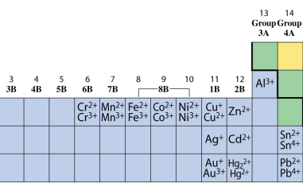
Transition Metals form Positive Ions
Most transition metals and Group 4(14) metals form
2 or more positive ions.
Zn²⁺, Ag⁺, and Cd²⁺ form only one ion.

Slide 15
Metals that form more than One Cation
The name of metals with two or more positive ions
(cations) use a Roman numeral to identify ionic charge.
Lead Pb²⁺ lead(II)
Pb⁴⁺ lead(IV)

Slide 16
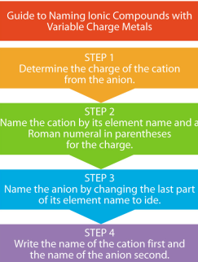
Naming Ionic Compounds with Variable Charge Metals
Copyright © 2005 by Pearson Education, Inc.
Publishing as Benjamin Cummings

Slide 17
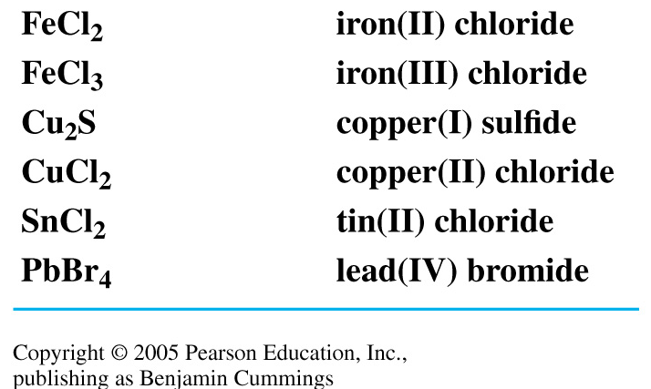
Naming Variable Charge Metals
Transition metals with two different ions use a Roman numeral after the name of the metal to indicate ionic charge.

Slide 18
Naming FeCl₂
To name FeCl₂
1. Determine the charge of the cation using the charge
of the anion (Cl⁻).
Fe ion + 2 Cl⁻ = Fe ion + 2- = 0
Fe ion = 2+
2. Name the cation by the element name and add a
Roman numeral in parenthesis to show its charge.
Fe²⁺ = iron(II)
3. Write the anion with an ide ending.
FeCl₂ = iron(II) chloride

Slide 19
Naming Cr₂O₃
To name Cr₂O₃
1. Determine the charge of cation from the anion (O²⁻).
2 Cr ions + 3 O²⁻ = 0
2 Cr ions + 3(2-) = 0
2 Cr ions - 6 = 0
2 Cr ions = +6
Cr ion = 3+ = Cr³⁺
2. Name the cation by the element name and add a
Roman numeral in parenthesis to show its charge.
Cr³⁺ = chromium(III)
3. Write the anion with an ide ending.
chromium(III) oxide = Cr₂O₃

Slide 20
Learning Check
Select the correct name for each.
A. Fe₂S₃
1) iron sulfide
2) iron(II) sulfide
3) iron(III) sulfide
B. CuO
1) copper oxide
2) copper(I) oxide
3) copper(II) oxide

Slide 21
Solution
Select the correct name for each.
A. Fe₂S₃
3) iron (III) sulfide Fe³⁺ S²⁻
B. CuO
3) copper (II) oxide Cu²⁺ O²⁻

Slide 22
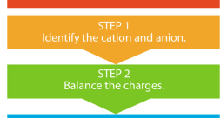
Guide to Writing Formulas from the Name

Slide 23
Writing Formulas
Write a formula for potassium sulfide.
1. Identify the cation and anion.
potassium = K⁺
sulfide = S²⁻
2. Balance the charges.
K⁺ S²⁻
K⁺
2(1+) + 2(1-) = 0
3. 2 K⁺ and 1 S²⁻ = K₂S

Slide 24
Writing Formulas
Write a formula for iron(III) chloride.
1. Identify the cation and anion.
iron (III) = Fe³⁺ (III = charge of 3+)
chloride = Cl⁻
2. Balance the charges.
Fe³⁺ Cl⁻
Cl⁻ = (3+) + 3(1-) = 0
Cl⁻
3. 1 Fe³⁺ and 3 Cl⁻ = FeCl₃

Slide 25
Learning Check
What is the correct formula for each of the following?
A. Copper(I) nitride
1) CuN 2) CuN₃ 3) Cu₃N
B. Lead(IV) oxide
1) PbO₂ 2) PbO 3) Pb₂O₄

Slide 26
Solution
The correct formula is
A. Copper (I) nitride
3) Cu₃N Need 3Cu⁺ and N³⁻
B. Lead (IV) oxide
1) PbO₂ Need Pb⁴⁺ and 2O²⁻

Slide 27
Naming Molecular Compounds

Slide 28
Substances that are composed of molecules are called MOLECULAR COMPOUNDS.
They are joined by covalent bond. Two or more non-metallic elements made up the most of molecular compounds.
A molecule that contains two atoms is called DIATOMIC MOLECULE.

Slide 29
NAMES and FORMULAS for BINARY MOLECULAR COMPOUNDS
Rules:
The name of a binary molecular compound ends in “ide,” just like the name of the binary ionic compound.
The name and the formula usually begin with the element that is more to the left on the periodic table.
In the name, use a prefix to specify the number of atoms of each element that are present in a molecule. Refer to Table 5.3 on page 162 for the prefixes used in naming a molecular compound.

Slide 30
Nomenclature of Molecular compounds
Name the least electronegative nonmetal first using the prefix denoting how many are in the formula then prefix + root of the most electronegative nonmetal + ide ending:
SO₃
Sulfur trioxide
IF₅
Iodine pentafluoride
CO
Carbon monoxide
N₂Br₄
Dinitrogen tetrabromide
Notice that the formula is written as least electronegative to most electronegative.
Notice that the number of elements in the compound is mentioned in the name.
Notice that the first nonmetal does not use a prefix if there is only one.
Prefixes:
1 – mono 6 – hexa
2 – di 7 - hepta
3 – tri 8 – octa
4 – tetra 9 - nona
5 – penta 10 - deca
There are also molecular compounds that only use their common name. For example:
H₂O is water
NH₃ is ammonia
H₂O₂ is hydrogen peroxide

Slide 31
PRACTICE PROBLEMS
Selenium monoxide
1. AsCl₃ 2. SeO
3. XeF₄ 4. B₂O₃
5. P₂S₃ 6. SiO₂
7. SF₆ 8. NI₃
9. PH₃ 10. CBr₄
11. P₄O₁₀ 12. OF₂
Arsenic trichloride
Diboron trioxide
Xenon tetrafluoride
Silicon dioxide
Diphosphorus trisulfide
Sulfur hexafluoride
Nitrogen triiodide
Phosphine, this is another exception.
Carbon tetrabromide
Tetraphosphorus decaoxide
Oxygen difluoride

Slide 32
Homework
Identify each of the following compounds as ionic or
molecular compound.
P₂O ₅ c) CaSO₄
KNO₃ d) CH₄
2) Name the following compounds:
MgBr₂ c) PbSO₄
CCl₄ d) K₂SO₄
3) Write the chemical formula of each of the following:
Ammonium bromide
Barium sulfate

