Slide 1
Rate of Reaction
Chemistry 10
Ms. Albarico

Slide 2
Students are expected to:

Slide 3
An important part of studying chemical reactions is to monitor the speed at which they occur. Chemists look at how quickly, or slowly, reactions take place and how these rates of reaction are affected by different factors.

Slide 5
Collision Theory
1. For a reaction to occur the particles must collide.
2. The colliding particles must have a minimum energy called the
Activation Energy.

Slide 6
Collision Theory
The KINETIC MOLECULAR THEORY may be used to explain how the various factors will affect the rate of a chemical reaction.
As the particles in the reactants move around, they collide with each other.
Most collisions do not result in anything but a few will cause the bonds in the existing molecules to break apart and new bonds will form to make new molecules.
Collisions that result in the formation of products are called EFFECTIVE COLLISIONS.
The idea of effective collisions is called the COLLISION MODEL and states that the rate of a reaction is affected by the number of effective collisions between reactant molecules.
According to the Collision Model, the rate of a reaction may be increased by increasing the number of total collisions or by increasing the number of effective collisions by decreasing the activation energy.

Slide 7
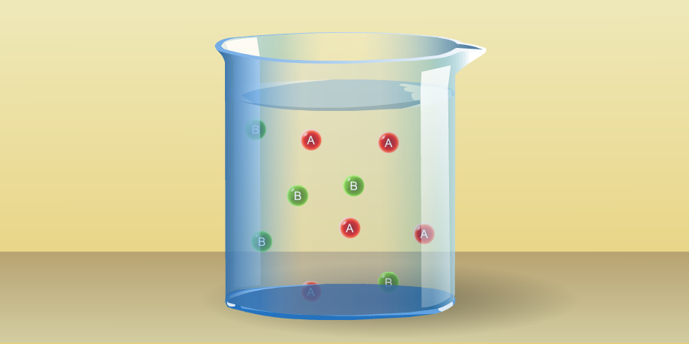
Collisions & Activation Energy

Slide 8
Rates of Reaction
The rate of a chemical reaction is the speed at which the reaction occurs (i.e. speed at which the reactants are used or products are produced).
Rate can be measured by the:
1) change in mass of reactants or products.
2) change in pH
3) change in conductivity (ion production)
4) change in colour (intensity of colour)
5) change in temperature
6) production of a gas

Slide 9
Factors that will affect the rate of reaction
1) Temperature
2) Surface Area
3) Concentration
4) Catalyst
5) Chemical Nature of Reactants
6) State of the Reactants

Slide 10
1. CONCENTRATION
The greater the number of particles the greater the number of total collisions. Since the total number of collisions has increased, the number of effective will also increase therefore the rate of the reaction will increase.
Factors that Affect Rate of Reaction

Slide 11
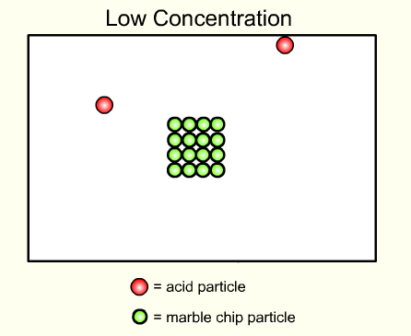
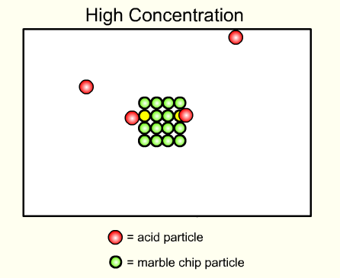
Increasing concentration increases the rate of the chemical reaction.

Slide 12
The effect of concentration
on reaction rate
HCl
+
Na₂S₂O₃
NaCl
+
SO₂
+
H₂O
+
S
The formation of a pale yellow precipitate of sulphur can be used to monitor the progress of the reaction.

Slide 13
Effect of concentration on rate
Conclusion ?
R
A
T
E
1
Time
Rate is directly proportional to concentration
CONCENTRATION
Notes:
NOTE: As a reaction proceeds, it tends to slow down.

Slide 14
2. PARTICLE SIZE (SURFACE AREA)
If the size of a solid particle is decreased, there will be more surface area available for collisions to occur.
Factors that Affect Rate of Reaction

Slide 15
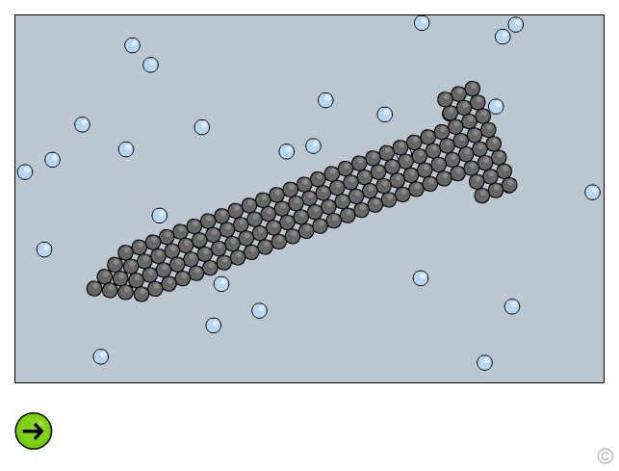
Smaller particles have a greater surface area.

Slide 16
The effect of particle size on reaction rate
HCl
+
CaCO₃
CaCl₂
+
H₂O
+
CO₂
The rate of release of CO₂ gas can be used to monitor the progress of the reaction
Notes:
16

Slide 17
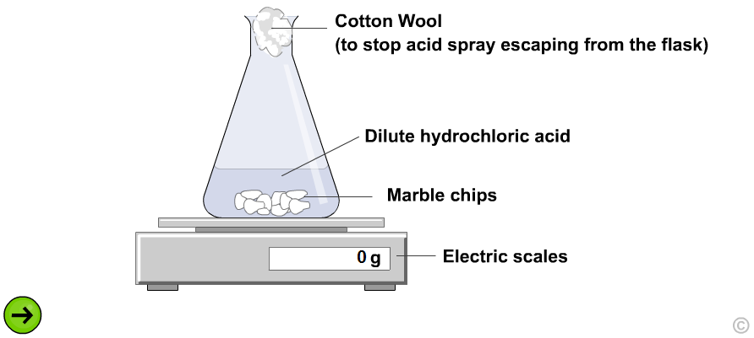
Add the HCl to a large chips of CaCO₃ in the flask.
As CO₂ is released the mass of the flask drops.

Slide 18
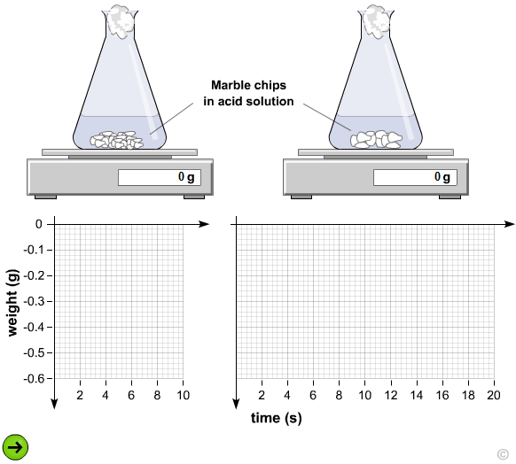
Finely divided particles react faster than large particles.

Slide 19
3. TEMPERATURE
The temperature of a substance is a measure of the average kinetic energy of the particles. The higher the temperature, the faster the particles are moving which will increase the chance for collisions.
Factors that Affect Rate of Reaction

Slide 20
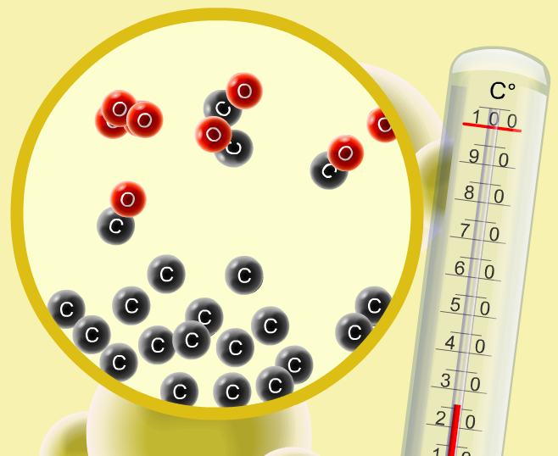
Temperature, Collisions &
Activation Energy

Slide 21
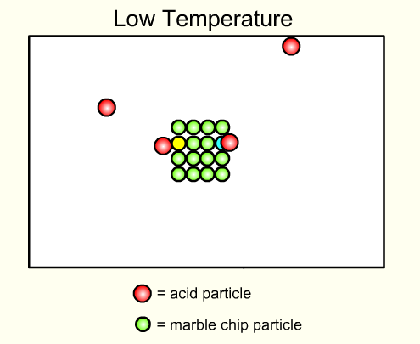

Effect of temperature on rate
Increasing temperature increases the rate
By increasing the number of collisions / sec
More of the colliding particles have E Act

Slide 22
The effect of temperature on reaction rate
HCl
+
Na₂S₂O₃
NaCl
+
SO₂
+
H₂O
+
S
The formation of a pale yellow precipitate of sulphur can be used to monitor the progress of the reaction
Notes:
22

Slide 23
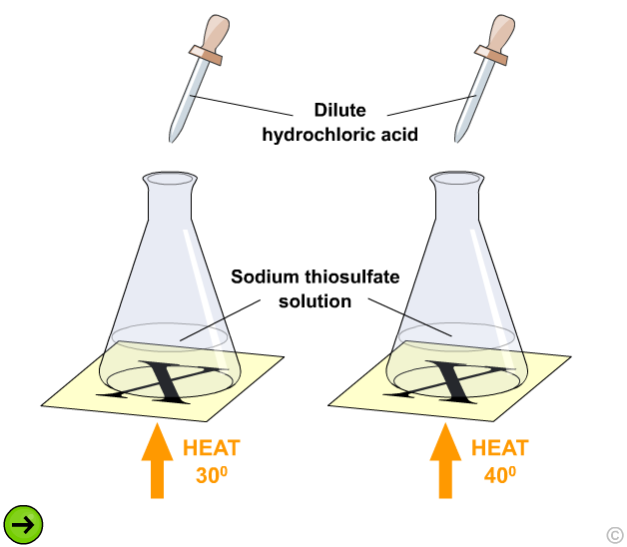
Next slide

Slide 24
Effect of temperature:
Conclusion ?
R
A
T
E
1
Time
Rate increases with increasing temperature
TEMPERATURE

Slide 25
Effect of temperature:
What is the main factor increasing rate between
A and B
R
A
T
E
1
Time
Rate increases due to increased collisions /sec
B
A
TEMPERATURE

Slide 26
Effect of temperature:
What other factor caused the large rate increase between
B and C
C
R
A
T
E
1
Time
More colliding particles have
E Act
B
TEMPERATURE

Slide 27
4. STATE OF REACTANTS
Reactions where all reactants are in the same state (homogeneous reactions) will occur at a faster rate than reactions where reactants are in different states (heterogeneous). This is because the reactants will have a greater opportunity of colliding.
Factors that Affect Rate of Reaction

Slide 28
The state of the reactants will also affect the rate. The relative rates are:
Gases → fastest
Liquids/ Solutions → fast
Solids → slow

Slide 29
5. NATURE OF REACTANTS
The type of reactants will determine the activation energy needed to break bonds and form the intermediate state called the ACTIVATED COMPLEX. The higher the activation energy, the slower the rate of reaction.
Factors that Affect Rate of Reaction

Slide 30
ACTIVATION ENERGY
Endothermic reactions are much slower than exothermic reactions because they tend to have higher activation energies.

Slide 31
Nature of Reactants
Ionic reactions are fast.
Na⁺Cl⁻
+
Ag⁺NO₃⁻
=
Ag⁺Cl⁻
+
Na⁺NO₃⁻
Mix solutions of sodium chloride and silver nitrate:
A precipitate of silver chloride forms instantly.
Ions are free to move in solution....no bonds to break.

Slide 32
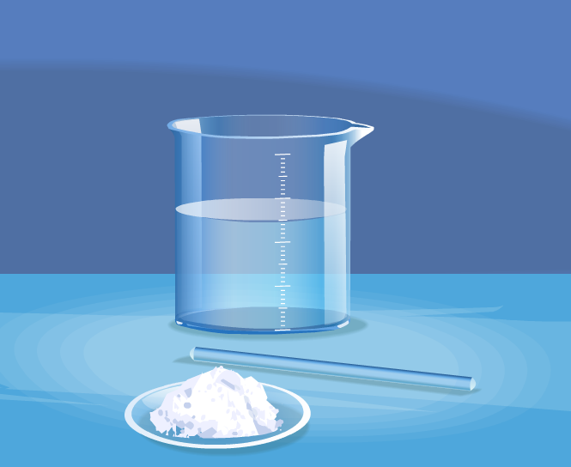
Sodium chloride + Silver Nitrate

Slide 33
Covalent reactions are slower than ionic
HCl
+
Na₂S₂O₃
NaCl
+
SO₂
+
H₂O
+
S
The pale yellow precipitate of sulphur forms slowly as covalent bonds in the sodium thiosulfate must first be broken before the reaction can occur
Notes:
33

Slide 34
6. CATALYSTS
A catalyst works by providing an alternative pathway for the reaction which has a lower activation energy. Lowering the activation energy will only increase the number of effective collisions. The number of total collisions will not be affected.
Factors that Affect Rate of Reaction

Slide 35
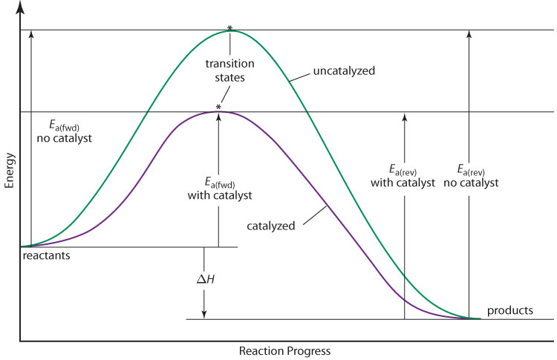
A Catalyst Influences the Reaction Rate
A catalyst lowers the E_{a} of a reaction.
this increases the fraction of reactants that have enough kinetic energy to overcome the activation energy barrier
a catalyzed reaction has the same reactants, products, and enthalpy change as the uncatalyzed reaction
A catalyst decreases both E_{a(fwd)} and E_{a(rev)}.
Notes:
Image source: MHR, Chemistry 12 © 2011. ISBN 07-106010-3; page 374

Slide 36
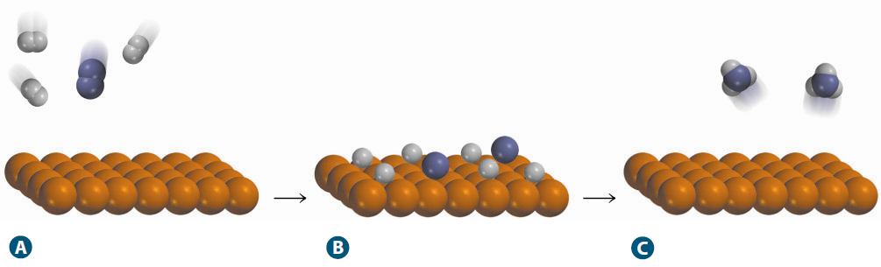
Catalysts in Industry
A metal catalyst is used for industrial-scale production of ammonia from nitrogen and hydrogen.
Hydrogen and nitrogen molecules break apart when in contact with the catalyst. These highly reactive species then recombine to form ammonia.
A catalyst (V₂O₅) is used for industrial-scale production of sulfuric acid from sulfur.
Notes:
Image source: MHR, Chemistry 12 © 2011. ISBN 07-106010-3; page 375

Slide 37
Catalysts in Industry
The Ostwald process uses a platinum-rhodium catalyst for the industrial production of nitric acid.
Many industries use biological catalysts, called enzymes, which are most often proteins.
For example: the use of enzymes decreases the amount of bleach (an environmental hazard) needed to whiten fibres used in paper production.

