Slide 1
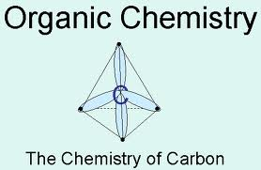
ORGANIC CHEMISTRY
Ms. Lilian Albarico

Slide 2
Students are expected to:
Illustrate, using chemical formulas, a variety of natural and synthetic compounds that contain carbon.
Distinguish between organic and inorganic compounds on the basis of their formulas.
Represent chemical reactions and the conservation of mass using molecular models, and balanced symbolic equations.

Slide 3
ORGANIC CHEMISTRY
Organic compounds consist mostly of atoms of carbon bonded together. The study of compounds that contain carbon and their properties is called ORGANIC CHEMISTRY.
A few carbon-containing compounds such as carbon dioxide, carbon monoxide, and ionic carbonates are not considered as organic.

Slide 4
Organic Compounds
Always contain carbon and hydrogen.
Always formed by covalent bonding.
Often quite large molecules or with many connected atoms.
Usually associated with living systems.

Slide 5
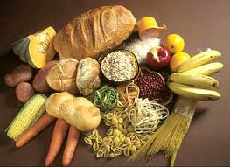
Organic compounds are usually found in common foods like:
Can also be found in:
sugar, starch, alcohol, medicines, polymers, steroids, waxes, polymers, perfumes
body PROTEINS (DNA – amino acids)

Slide 6
Carbon contains four valence electrons. Rather than gaining or losing four electrons to obtain a stable octet, it forms covalent bonds readily. Carbon can form single, double, or triple bonds.
For example, carbon can make two single bonds with neighboring carbon atoms, and still have the ability to make two more single bonds or a double bond with atoms of carbon or other elements.

Slide 7
Carbon Atoms
Contain a total of 6 electrons.
Only four electrons in the outer shell.
Very diverse as one atom can bound with four other atoms.
Often bond with other carbon atoms to make hydrocarbons.
Can produce long carbon chains like octane.
Can produce ring forms like cyclohexane.

Slide 8
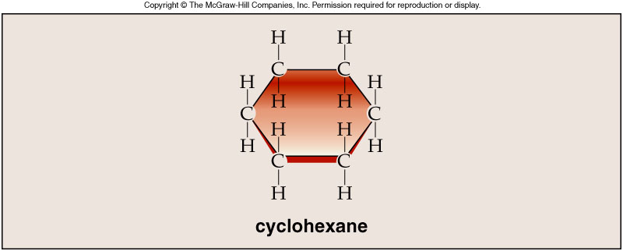
Octane & Cyclohexane

Slide 9
A HYDROCARBON is an organic compound that contains only carbon and hydrogen atoms.
The two main sources for the hydrocarbons we use are crude oil and natural gas.
Gasoline(with octane C₈H₁₈) is a homogenous mixture of hydrocarbons. The result of burning crude oil and natural gas is that we can heat our homes, businesses and schools, and provide energy for transportation.

Slide 10
Did You Know?
Crude oil is found over 50 countries of the world but more than 70% of the known reserves are in the Middle East. Crude oil is the second most common liquid on Earth.

Slide 11
HYDROCARBON
The simplest hydrocarbon is METHANE (CH₄).
Other examples are:
Ethane, Propane, Butane

Slide 12
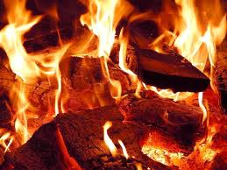
Combustion Reaction

Slide 13
A COMBUSTION REACTION is a result of organic compounds reacting rapidly with oxygen and in which both heat and light are given off.
When hydrocarbons are burned when there is plenty of oxygen, COMPLETE COMBUSTION occurs. This reaction produces carbon dioxide and water vapour, and at the same time generates energy.
hydrocarbon + oxygen gas(good supply) → carbon dioxide + water

Slide 14
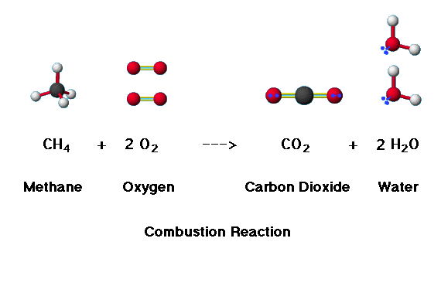

Slide 15
Hydrocarbons that are burned in a poor supply of oxygen, results INCOMPLETE COMBUSTION.
In this case, the products of incomplete combustion are carbon dioxide and water, as well as carbon (SOOT) and carbon monoxide. CARBON MONOXIDE is a colourless highly toxic gas. If carbon monoxide enters in our lungs, it will bond faster with hemoglobin than oxygen. All living organisms require oxygen to survive. If there is less hemoglobin available to carry oxygen, cells may die.

Slide 16
Which flame from a bunsen burner do you think that undergoes incomplete combustion?

Slide 17
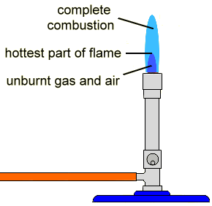

Slide 18
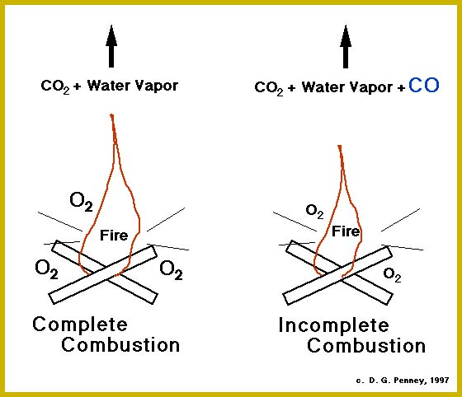

Slide 19
Silent Reading
(Refer to the map of Canada’s oil and gas resources on page 203.)
Read page 205 “Off the Wall” about Ethenes.

Slide 20
Homework!
What is organic chemistry? Give four examples of organic compounds.
How are the products of the complete combustion of a hydrocarbon different from those of incomplete combustion?
How would observing the flame of a burning hydrocarbon help you determine whether the combustion is complete or incomplete?

Slide 21
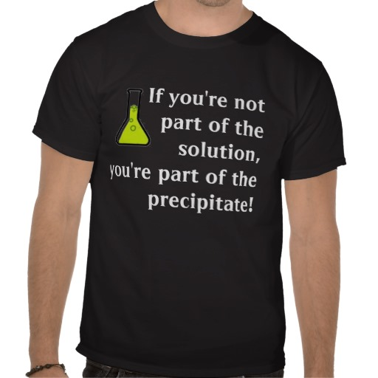
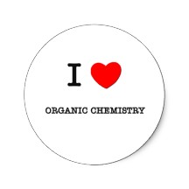
Fun Project
You are going to design a T-shirt (white or black) with different chemical logos or chemical formula!
All students will wear it on a special day. No one should have the same prints!

Slide 22
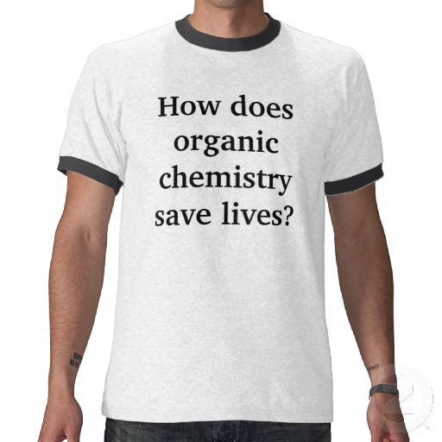
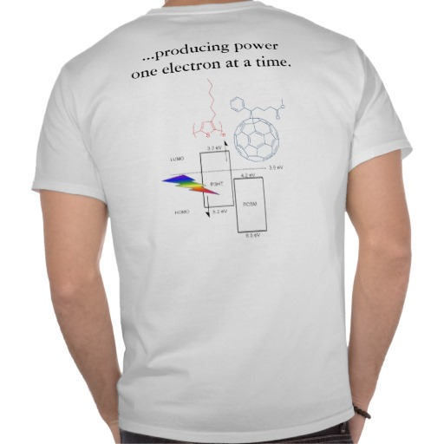

Slide 23
